Slide 1
Equally Inclusive Volunteer Pool
Presented by: crystal petry
Golden triangle rsvp director

Slide 2
Why are the Caucasian volunteers so massive? Is it because minorities do not volunteer? Is it because the Caucasian race values volunteering more than the minority ethnicity? According to a 2015 Bureau of Labor Statistics report (www.bls.gov/news.release/volun.nro.htm) “Volunteering in the United States”, it states that among the major ethnicity groups, the Caucasians continues to volunteer at a higher rate. While the numbers for minorities who volunteer are significantly lower, it still answers the question-yes minorities do volunteer.

Slide 3
African Americans 19.3% Asians 17.9% Hispanics 15.5% Caucasians 26.4%
2015 Bureau of labor statics report
“Volunteering in the United States”; Caucasians continue to volunteer at a higher rate.

Slide 4
My ideology or assumption is that the lack of inclusiveness within volunteers is not viewed as “…improper, immoral or wrong” (Neuman, 2013) by the vast majority of Americans; therefore, it is “…fixed, inflexible and unquestioned.” (W. Lawrence Neuman 2013) As I work on this project, it occurs to me that the first objective must be to get the vast majority of Americans to see that there is a clear problem when not just volunteers, but any group of people is primarily one ethnicity. Then once that is identified, then we can work on the strategic change to fix it.

Slide 5
Golden Triangle RSVP Ethnicity Breakdown 2014
Hispanic or Latino 6
Non-Hispanic or Non-Latino 508
American Indian 0
Alaskan Native 0
Black or African American 99
Native Hawaiian 2
Caucasian 404

Slide 6
Things I Want You to Learn & Take Away From This Presentation
Look at your volunteer pool & advisory council demographics. What do you see? Who do you see?
How to purposely recruit for an Equally Inclusive Volunteer Pool

Slide 7
The assumption can be made that people are unaware of the social norm to target a certain group of people to volunteer, but the assumption can also be made that some people fight to preserve past and current social norms.
Nueman 2014
Social Research Methods: Qualitative and Quantitative Approaches, W. Lawrence Neuman

Slide 8
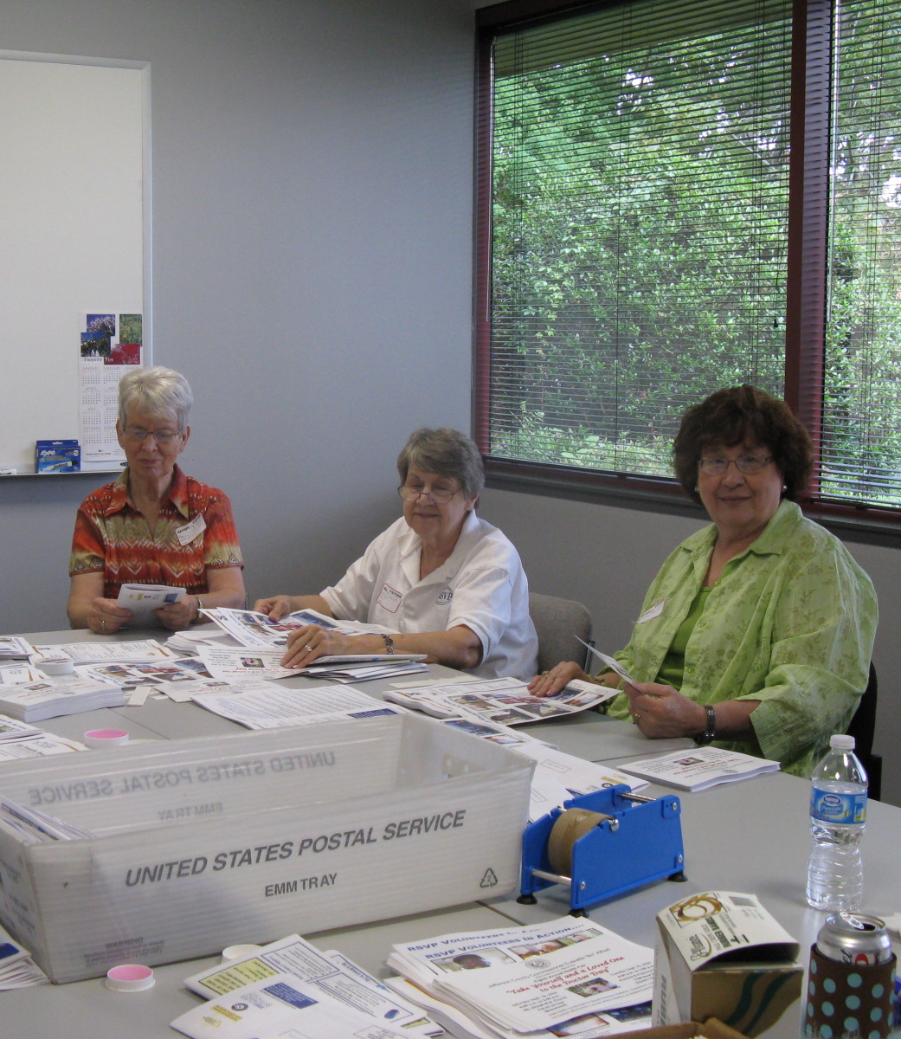
Golden Triangle RSVP Volunteers

Slide 9
Equally Inclusive Volunteer Pool Presented by: Crystal Petry
With a targeted approach, using a multi-media platform having an equally inclusive volunteer pool can easily be fixed. The approach that I am recommending is not a quick fix approach, with time effort and a small or large amount of money (depending on budget) your volunteer pool whether non-profit or for-profit will add value to your community and help expand services.

Slide 10
How Do You Recruit an Equally Inclusive Volunteer Pool?
Go to the neighborhoods of African Americans, Hispanics, Asians, etc
1
Go to the schools, find out about meetings
2
Get Public Service Announcements (PSAs) played on different radio stations
3
Get an article written in an Hispanic Newspaper/ Magazine
4
Use Social Media
5

Slide 11
In order for me to see what worked as far as recruiting and what did not work, I created an excel sheet to keep track of the recruiting numbers. “Measuring helps us see what is otherwise invisible and it lets us observe things that were once unseen and unknown but predicted by theory.”
(Neuman, 2013)

Slide 12
Tracking Form Jan-Dec 2019
Marketing Campaigns Compiled |  |  | 2019
Recruit | Volunteer | Channel 6 | Speakers | Facebook |  | Site | Beaumont | KFDM | The | Other | Total
Source | Referral | Commercial | Bureau | Advertising |  | Posters | Enterprise |  | Examiner | Source
Recruit count | 1 |  |  | Clara Velasco (06/24 - 07/31) | 4 |  |  |  |  |  | 5
 |  |  |  | Chris Kirkendall (08/01-08/31) | 2 |  |  |  |  |  | 2
 |  |  |  |  |  |  |  |  |  |  | 0
 | 1 | 0 | 0 |  | 6 | 0 | 0 | 0 | 0 |  | 7
 | Male | Female | Total
Recruited |  | 7 | 7
 | Hispanic/ Latino | American Indian/ Alaska Native | Asian |  | Black/ African American | Native Hawaiian/ Other Pac. Islander | White | Total
Recruited |  |  | 1 |  | 3 |  | 2 | 6

Slide 13
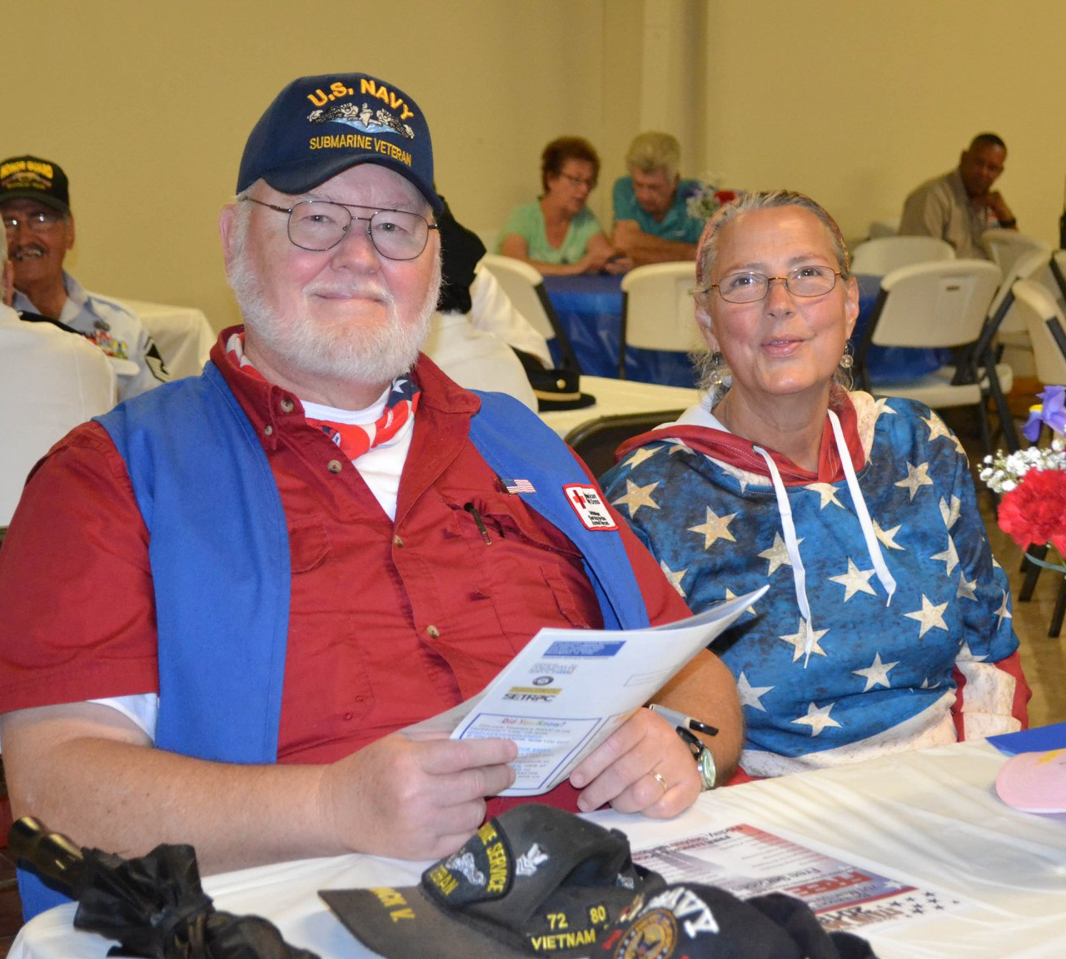
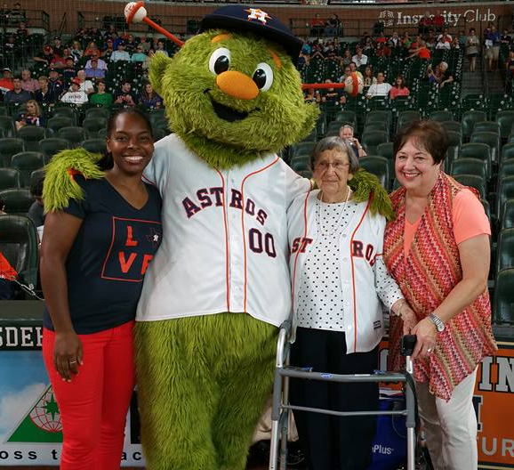
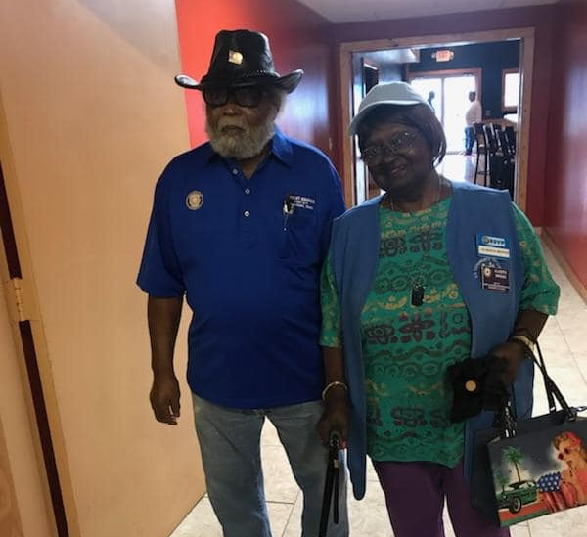
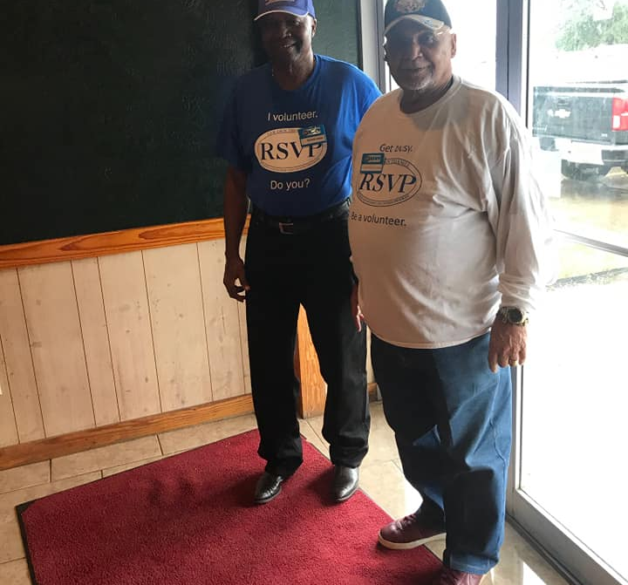
Equally Inclusive Volunteer Pool Presented By: Crystal Petry
This is not a Check Box System:
When the word “priority” is used in this context the underlining meaning to that word is that it is an ongoing priority. Meaning that recruiting people of color and men must be a never-ending priority for your organization.

Slide 14
Equally Inclusive Volunteer Pool Presented by: Crystal Petry
Mary Dole, with Volunteer Weekly(www.volunteerweekly.org), says “Building a strong, diverse volunteer program that mirrors your community will mean your organization is much better placed to reach people who need or would value your services. As our communities become more diverse, we need to realize that there are benefits to reflecting these changes and disadvantages to not.” Dole says you can’t serve your clients in the most effective manner if you don’t represent them.

Slide 15
Golden Triangle RSVP Advisory Council

Slide 16
Golden Triangle RSVP Ethnicity Breakdown 2015
16 Male Volunteers
6 African Americans
1 Hispanic

Slide 17
It has been 391 years since the word volunteer was introduced and during that time volunteer was exclusively for Caucasian men and women. That visual of exclusively and primarily Caucasian men and women volunteering has been ingrained in our thoughts and actions. While it took over 300 years for that indoctrination, it will take just as long to undo it. In 391 years of racial prejudice, racial divide, racial stereotypes we have come a long way as a society. We see; to some extent, the need for diversity in the Fortune 500, all political arenas, the medical field, sports, and even the advertising field. And many companies both large and small have actively started making changes to be more inclusive, both written and in action. But in all of that change and inclusion in the workforce-inclusion in the volunteer pool has been either forgotten, ignored, or not even considered. I tend to believe it is the latter of the three. The normative statement here is all volunteer pools need to be equally inclusive.

Slide 18
Talent is equally distributed, opportunity is not.
Leila janah

Slide 19
Thank You For Listening!!!!

Slide 20
Time for Questions & Answers

