Slide 1
Understanding Why People Donate Their Time

Slide 2
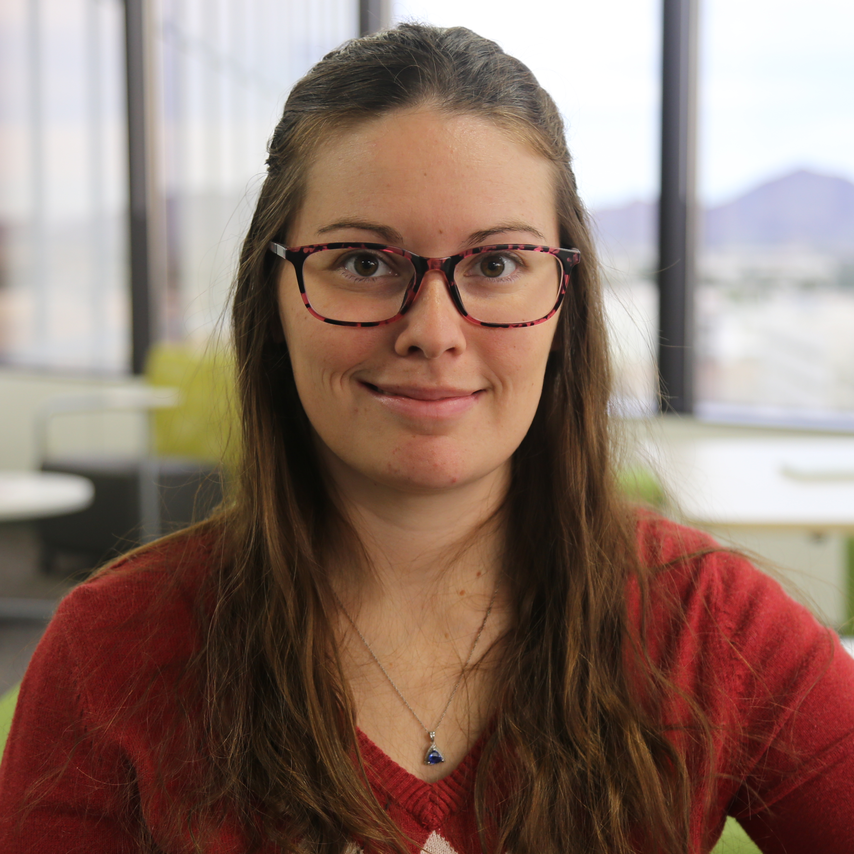
Alex Kouumdjieva
Director of Marketing and Operations
Fundraising Academy Cause Selling Education
Board Member – YNPN Phoenix

Slide 3
Our mission
To help nonprofits significantly increase their fundraising capabilities and impact they have in their communities and society, through proven contemporary curriculum presented by world-class nonprofit leaders, best in class faculty and renowned philanthropists.

Slide 4
Notes:
As of February 28, 2021

Slide 5

Affiliate partners
Iowa Wesleyan University
(IA)
City University of Seattle
(WA)
St. Augustine College
(IL)
Candid
(OH)
Long Island University
(NY)
Candid
(CA)
Candid
(NY & DC)
Howard University
(D.C.)
Texas A&M University
Central Texas
(TX)
National University System
(Founding FA)
Kentucky State University
(KY)
First Tee
(FL)
Texas A&M International University
(TX)
Xavier University
of Louisiana
(LA)
Nova Southeastern University
(FL)

Slide 6




Objectives
Appreciate the role that psychology plays in how supporters make decisions
Consider the impact of the pandemic on volunteering
Study the communication process and how it relates to your prospective volunteers
Recognize barriers to effective communication
Notes:
DO:
Review Objectives
This segment is devoted to helping unravel one of the greatest uncertainties in nonprofit fundraising, which is understanding what ultimately drives a supporter to give their time and money, and to choose one cause over another.
It’s impossible to apply blanket statements as to why people support causes; however, what is in our control is our ability to understand the decision-making process that supporters undergo, so we will do our best to do that in the next hour and a half.

Slide 7
Poll question
Have you volunteered
in the last 12 months?
Notes:
Insert Poll Question:
Have you volunteered in the last 12 months?
Answer options:
Yes
No
No, but I did volunteer in the 12 months before the pandemic.

Slide 8
Why do people give their time?

Slide 9
Let’s chat about it!
Why do people give their time?
What is the number one reason a person decides to volunteer with a nonprofit?
Notes:
DO:
Ask each question on the slide one at a time, and prompt participants to brainstorm answers.
Then, share the real answer to question two: The number one reason a supporter decides to volunteer with a nonprofit is because they were asked.
FA Instructor Note: This answer is in the chapter they were asked to read as part of their pre-work.
OPTIONS/IDEAS:
Some examples of why people give:
To gain a sense of closeness to a community or group.
To feel they are changing someone’s life.
To get a tax deduction.
To appease a friend or colleague who asked them to donate.
To create a good image for themselves in their community or for their company.
To be seen as a leader or role model.
To feel they are not powerless and can still affect real change.
To leave a legacy that perpetuates them, their ideals, or their cause.
To memorialize someone who is dealing with or has died of a disease.
To feel connected to other people and build their social network.
Because they felt emotionally moved by someone’s story.
Because they were raised to give back; philanthropy is a tradition in their family or culture.
Because supporting a certain nonprofit is in style (i.e., wearing the latest colored wrist band or taking the latest challenge that has gone viral on social media).
Because they feel fortunate and/or guilty and want to give something back to others.
Because they believe in an organization’s mission and want to help move it forward.
Because giving feels good.
Number one reason a supporter decides to volunteer:
The more nonprofits seek to answer the big question, “Why do people give (time and money)?” the clearer it becomes that there is no single right answer. While the reasons may vary, one thing remains clear. In a landmark study that drew on the research of more than 500 other papers, researchers found that for more than 85 percent of charitable donations, people gave because someone asked them to give. That conclusion bears repeating:
People give because a fundraiser asked them to give!

Slide 10



The power of our brains
PSYCHOLOGICAL INFLUENCES
SOCIOCULTURAL INFLUENCES
Culture
Customs
Physical Environment
Social Class
Perception
Mood
Attitudes
Self-Image
Notes:
Our brains are amazing; they are designed to synthesize our conscious experiences of the external world. This means that in some ways, we do not experience the world, but rather we experience the version of the world that our brains have created. In short, perception is reality.
If you aren’t convinced, think about this: Apple is only Apple because Steve Jobs convinced us that we need to pay a lot more money for something that does a similar job to other products. Many now consider it a fact. Another example is Starbucks—a company that made it socially acceptable (and even trendy) to spend $9 on a cup of coffee.
What we see and hear becomes acceptable and eventually becomes “truth.”
We perceive situations according to our own personal needs, values, expectations, past experience, and training. That is why a person’s individual mood, attitude, and self-image all factor in heavily to what they see as indisputable certainties.

Slide 11



The psychology of giving
MOOD
ATTITUDE
SELF-IMAGE
Notes:
Let’s dig deeper into mood, attitude, and self-image.
Mood: The current mood of the individual, the community, or even the country can play a role in the donor’s perceptions.
Attitude: Attitude plays a big role in perception. When you break them down, attitudes are merely habitual patterns of thought and response to stimuli. Over time, attitudes become automatic and are used to save the time that would be required to think about a situation and decide how to react.
Self-Image: Self-image is an individual’s unique and personal appraisal of themselves. It can have a great deal of influence on a donor’s tendency to be a conspicuous donor—someone who wants others to know exactly how much they gave. Some speculate that conspicuous giving is a way for donors to compensate for a negative self-image, while others suggest that conspicuous donors like to lead by example. Either way, a person’s self-image undeniably plays a substantial role in connecting with causes and deciding how much and how visibly to give.

Slide 12

Notes:
Play video up to 1:28.

Slide 13
Has volunteering changed in the last year?

Slide 14
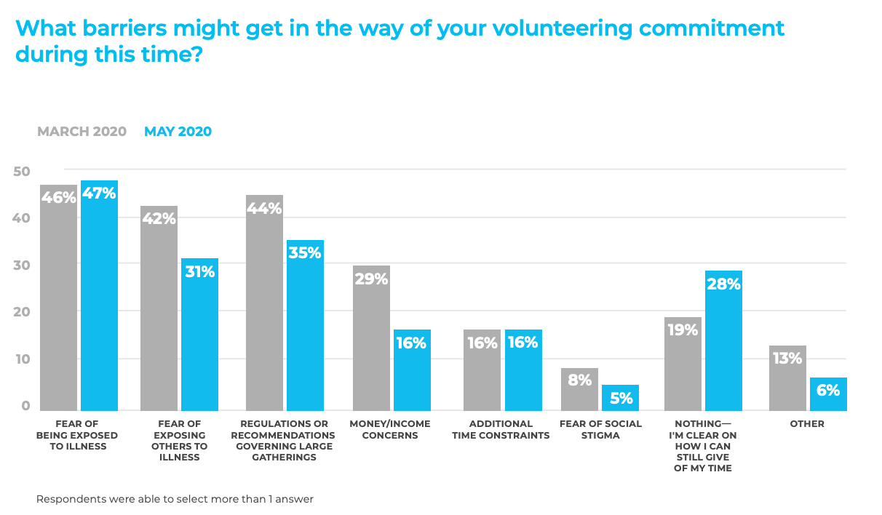
Of course it has!
Source: The Impact of COVID-19 on Volunteering, VolunteerMatch

Slide 15
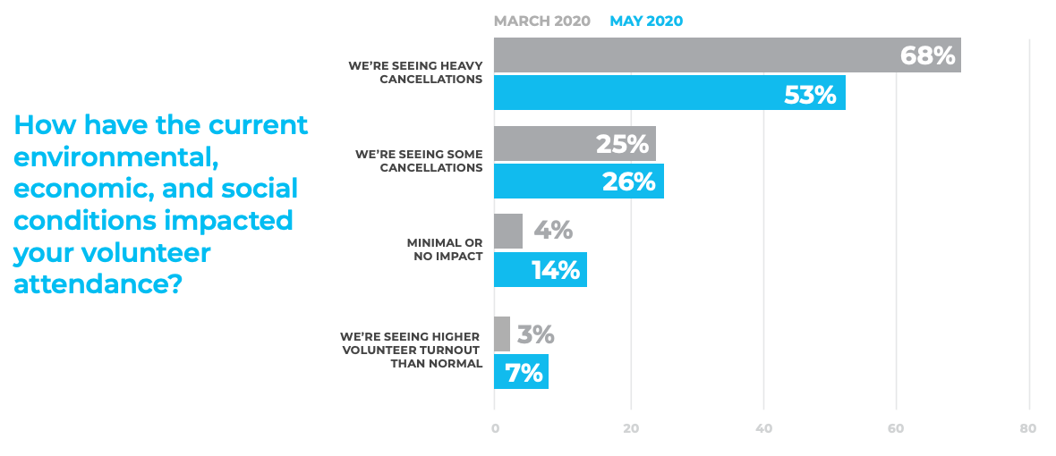
But it’s improving.
Source: The Impact of COVID-19 on Volunteering, VolunteerMatch

Slide 16
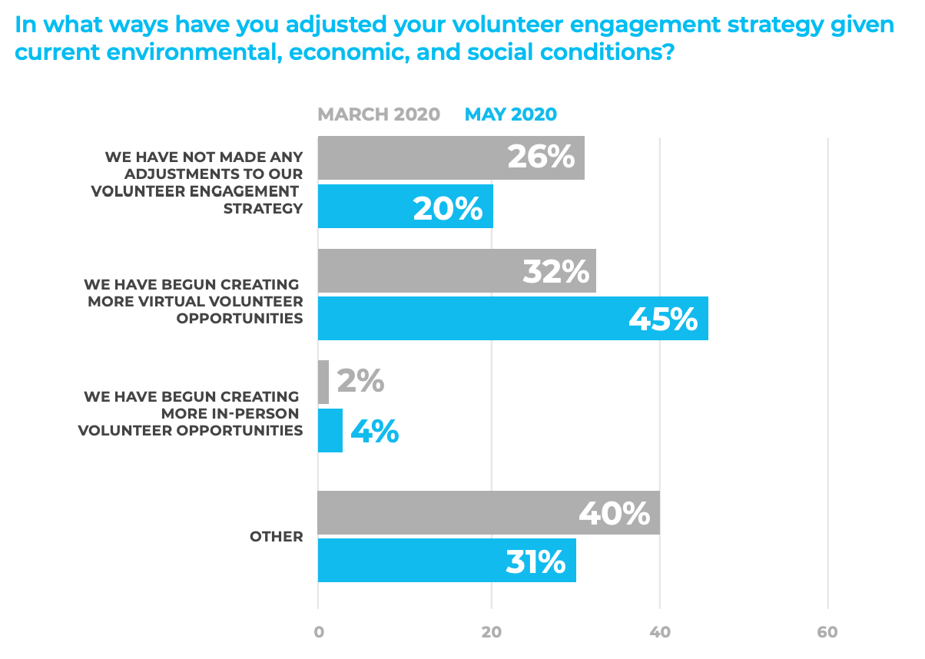
Because we’re adapting.
Source: The Impact of COVID-19 on Volunteering, VolunteerMatch

Slide 17
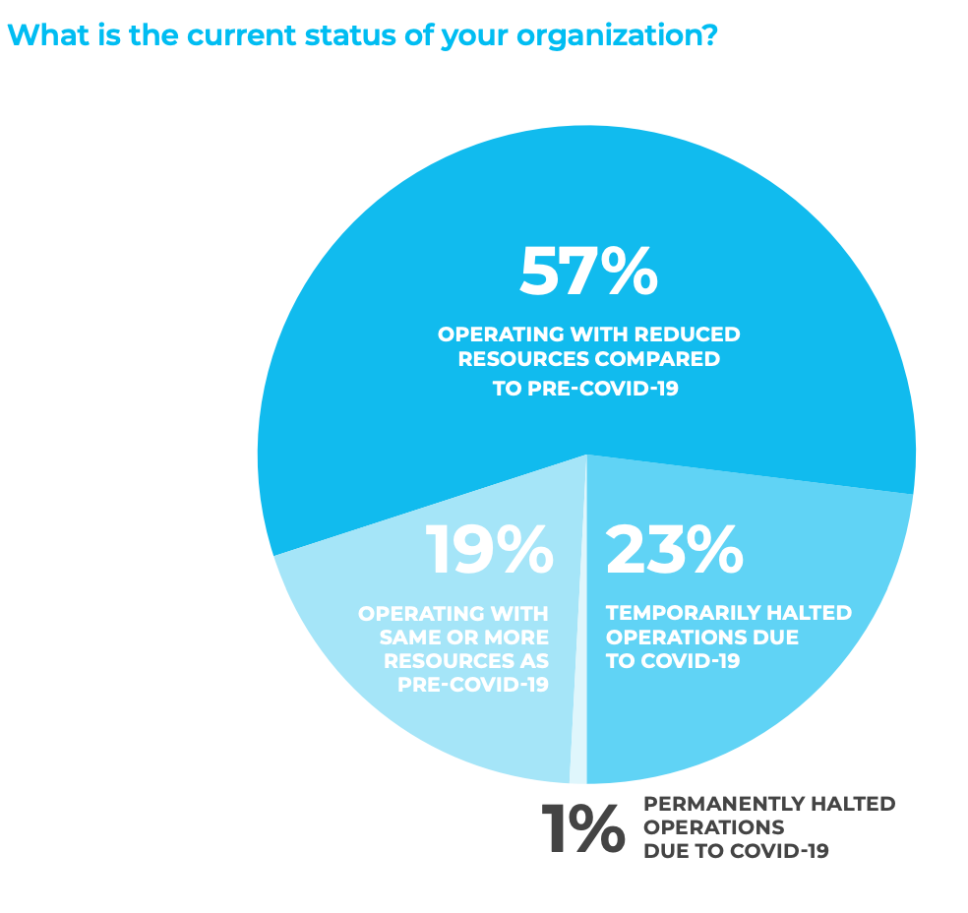
Despite decreased budgets.
Source: The Impact of COVID-19 on Volunteering, VolunteerMatch

Slide 18
Has the why behind volunteering changed?

Slide 19
Who are your volunteers?
The why hasn’t changed because of the pandemic, but it does change based on who your volunteers are.
Different demographics = different motivations
If you have data on your volunteers, look through it and see if you notice trends!
If you don’t have data, ask!

Slide 20
What is motivating them?

Slide 21
Let’s chat about it!

Slide 22
Okay, so we know why.
Now what?

Slide 23

TOMA
Top-of-mind Awareness
Notes:
TOMA = Top of Mind Awareness
As we’ve learned, volunteers and donors are making all kinds of decisions every minute based on many factors. One of the primary factors that influences giving is who comes to mind.
You want to become a perennial favorite. And the only way to do that is to consistently provide volunteers and prospective volunteers with regular correspondence about the work of your nonprofit in the ways that resonate best with them. They must be able to see and feel that you are doing the work you say you are.
You don’t want to be A Lingering Bad Taste - “I volunteered last year, and it didn’t really seem like they needed my help, so I’m not volunteering again this year.”

Slide 24
Breakout session
How will you maintain TOMA using…
Group 1: Social Media
Group 2: Email
Group 3: Snail Mail
Group 4: Events
Notes:
Breakout Rooms: Four groups (3-10 individuals per group) for five minutes. If too many or too few people per group, feel free to adjust the number of groups accordingly. We can make it work with any number of groups.
ACTIVITY:
Separate participants into four equal groups (breakout groups recommended) and assign each group one of the four categories (social media; email; snail mail; events).
Each group will select a scribe. If the platform allows, the scribe will share their screen.
Over the next five minutes, each group will quickly brainstorm and document all the ways they can maintain TOMA utilizing their assigned category.
After 5 minutes, bring everyone back together. Ask each scribe to report out.
Sharing your screen, open the shared folder and prompt each group’s scribe to share their findings. Jot down new ideas as they surface in the group discussion.
Ultimately, the end product is four solid lists, one for each category.

Slide 25
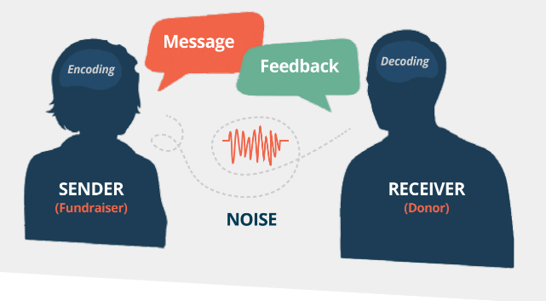
The communication model
Notes:
Cause Selling thrives on good communication. For the purposes of our discussion, we’ll define communication as the verbal and nonverbal passing of information between you, the sender, and your prospective donor, the receiver. For effective communication to take place, each person must understand the intended message.
Thus, the ultimate goal of communication is a mutual understanding that leaves both parties feeling heard.

Slide 26

The mental process of communication
Encoding the message
The message itself
Decoding the message
Notes:
Because communication is affected by the assumptions and needs of both parties—as well as by external factors—the process is often far from perfect. However, you can greatly increase your chances of having more successful and productive communication by understanding the process.
Encoding: the process in which you put your ideas into a format (a mix of words, visuals, and more) that will resonate with the volunteer. Effective encoding of your message is based on a thorough knowledge of the prospective volunteer’s motivations and preferences. The goals of encoding are to influence the attitudes and behavior of a prospective volunteer and to help move volunteers through the decision process, so they are able to confidently say yes to the ask.
The Message: a blend of symbols that are used to influence a change in a prospective volunteer’s attitude or behavior, and it involves both verbal and nonverbal elements. The most common symbols used in delivering a message are words, pictures, numbers, sounds, smell, body movement, and taste. Did you know that words convey just 7 percent of our message, and tone of voice accounts for another 38 percent!
Decoding the Message: the mental process by which your supporters figure out the meaning of a message. This happens automatically, much of the time without the message receiver even being aware of it. At this step in the process, either real communication or misunderstanding will occur. If the message was understood as intended and accepted, there is no problem. If the prospective supporter fails to understand the message, the result is called noise, which is any factor or element that interferes with or distorts understanding of the intended message.

Slide 27


Barriers to communication
Choice of words
Visual distractions
Overcomplication
Bad listening habits (yours or theirs)
Timing (if your prospect is having a bad day, that’s out of your control. Reschedule and don’t stress)
Notes:
When noise is present, a breakdown in understanding and connection occurs.
Noise can take many forms that may affect any part of the communication process.
There are logical reasons your message may not be understood or accepted.
Here are some reasons for such miscommunication:
Choice of Words:
All language is code. Even if you and your prospect use the same words, you are likely putting out different meanings.
This is especially true with electronic communication, where it is difficult to interpret the true meaning of words without voice inflection or nonverbal clues.
Examples:
Casual profanity
Verbiage that implies the listener is poorly informed
Language that assumes they know too much
Language that obscures the real meaning
Visual Distractions:
Any element that causes your prospect to focus on something other than your cause is a distraction.
Typical distractions:
Cell phones not set to airplane mode
Inappropriate dress
Uncomfortable room temperature
Confusing language in a brochure or presentation
The environment in which you meet your prospect can be a source for distractions
Select a controlled setting that is quiet and semi-private as opposed to a restaurant or coffee shop that is buzzing with activity.
Overcomplication:
Information overload often complicates a message.
Prospects need time to process information from different sources.
Examples:
Multimedia presentations that use videos, slides, photos, states, infographics, and more could be too much to take in.
An unconscious desire to appear personally knowledgeable often results in the fundraising talking too much.
Poorly organizing the presentation, or wrongly assuming the prospect has adequate knowledge of the cause.
Complicated vocabulary, jargon or technical terms
When in doubt, keep it simple. If you have a chance of being misunderstood, you will be.
Opt for small over large words.
They add a streamlined elegance to your writing and speaking.
Avoid using technical terms or jargon without clarification.
Bad Listening Habits:
If the prospect is not a great listener, this is a fundamental issue that is tough to overcome without creative problem solving.
If you sense that the prospect is not tuned in, try a different approach.
Shake things up with visuals.
Ask more questions to make sure the meeting becomes a dialogue, not a lecture!
Timing is Everything:
If a prospect has a reason for not wanting to listen, no amount of communication skill on your part will be enough.
Typical Issues/Reasons:
They may not feel well
They may be preoccupied with another task.
They may be facing a pressing deadline.
They may be thinking about a disagreement from earlier that day.
Some prospects need time to warm up; others want to skip the small talk.
If you sense the timing isn’t right, it’s okay to reschedule.
The prospect will more than likely appreciate the opportunity to meet with a clearer mind.

Slide 28
Poll question
What has been your biggest barrier to communication with volunteers?
Notes:
Insert Poll Question:
What has been your biggest barrier to communication with volunteers?
Answer options:
Choice of words
Visual distractions
Overcomplication
Bad listening habits
Timing
Other (share in the chat)

Slide 29
What are their communication preferences?

Slide 30
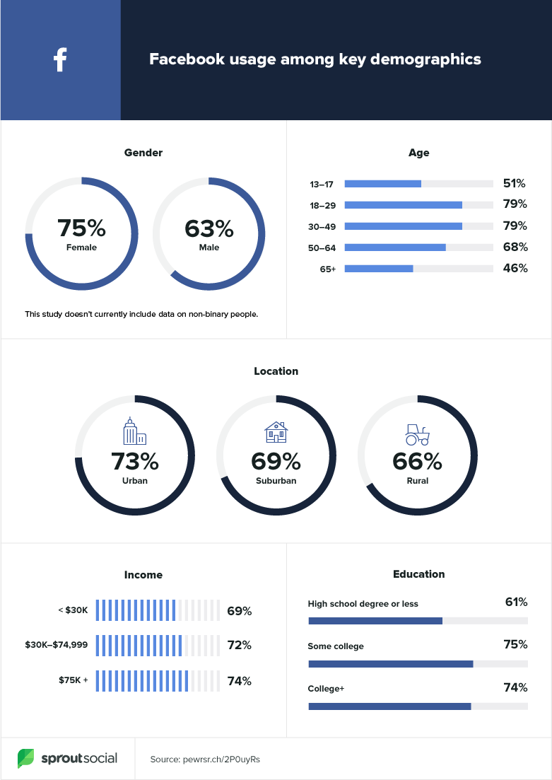
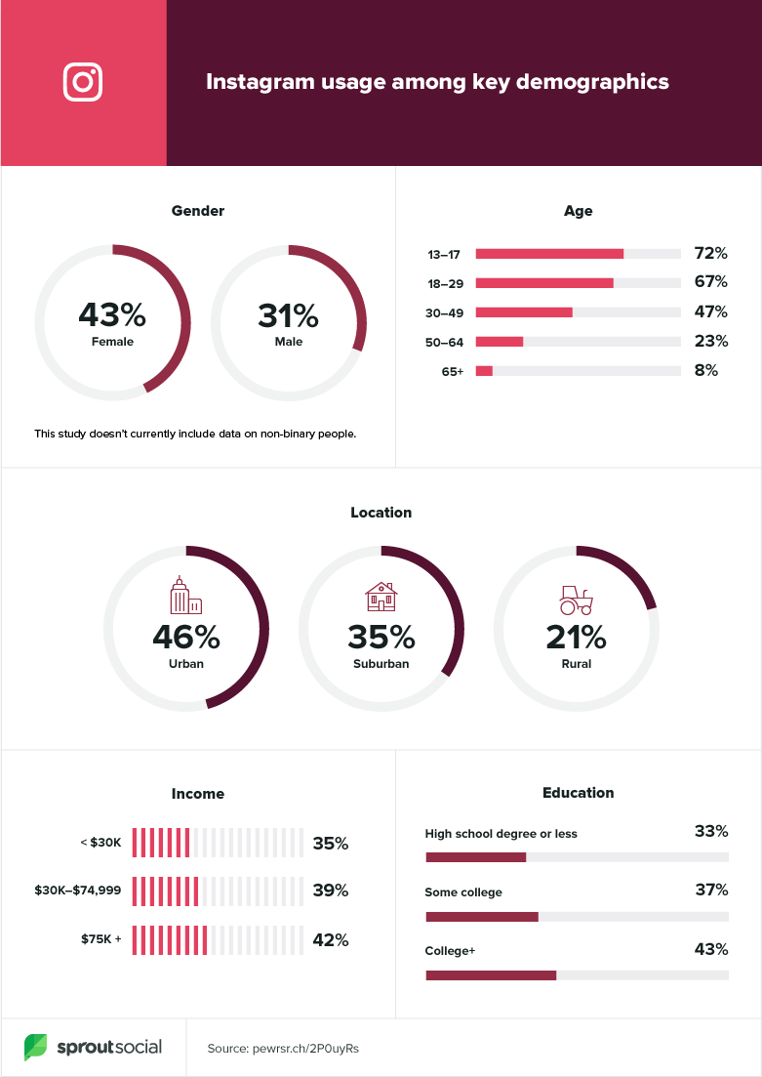
Source: SproutSocial

Slide 31
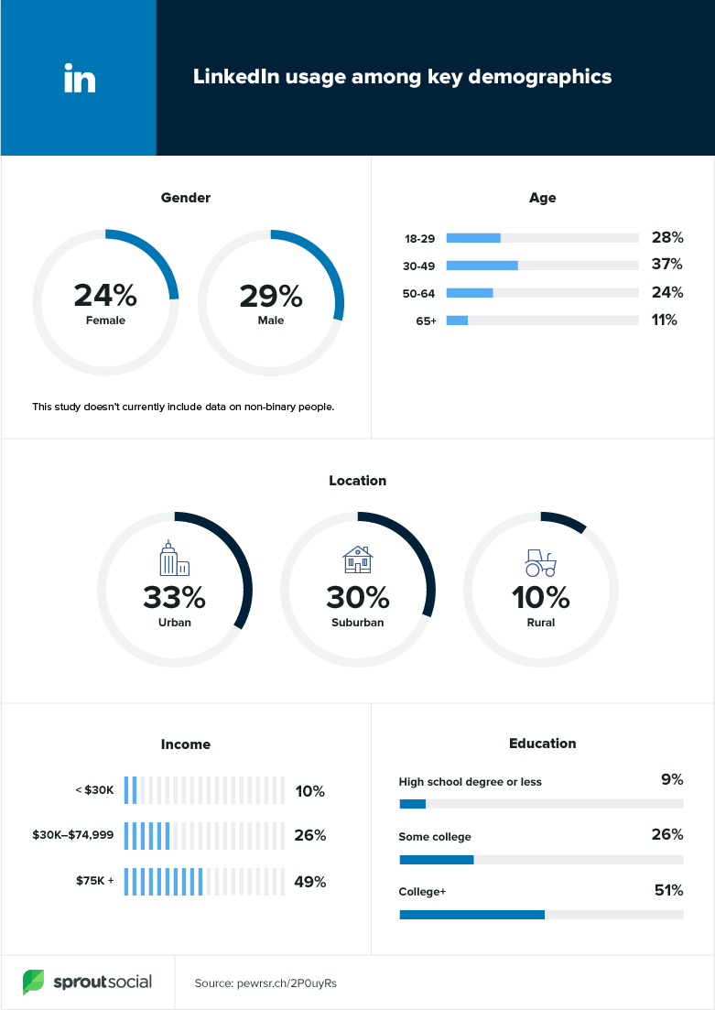
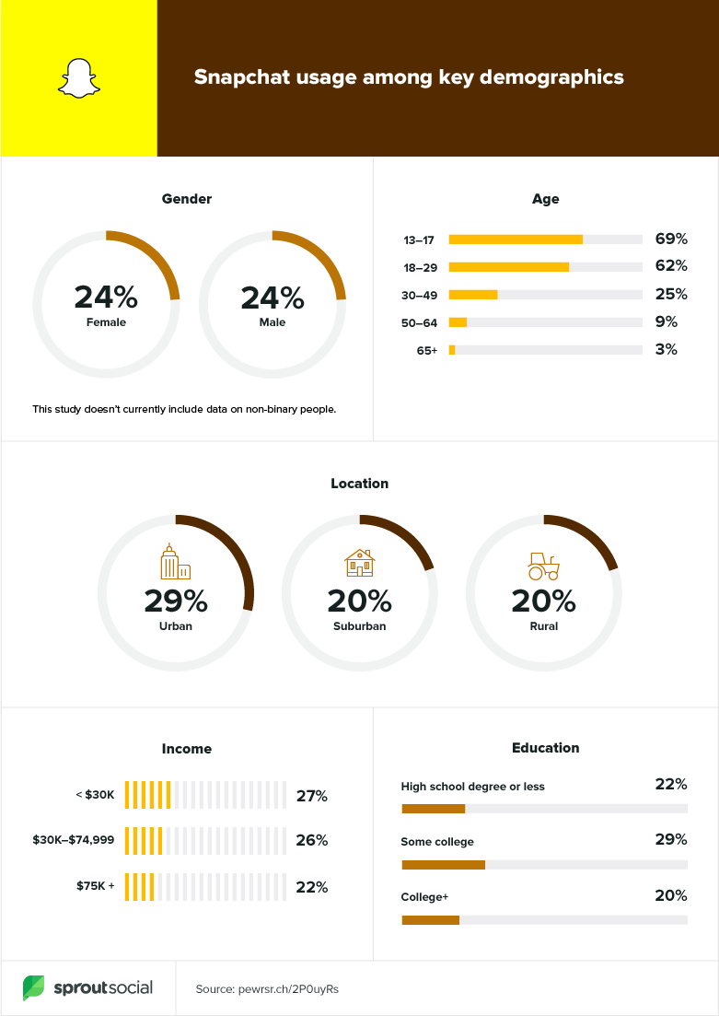
Source: SproutSocial

Slide 32
Summary
Internal and external forces play a role in decision-making, but internal forces are the strongest.
The pandemic has impacted volunteering, but not why people volunteer.
Get that TOMA.
Avoid common barriers to effective communication – choose your words wisely.
Consider your audience, what is important to them, and their communication preferences.
Notes:
DO:
Summarize content.
Answer remaining questions.
Ask guiding questions to reinforce learning and ensure students have absorbed the content.
TALKING POINTS:
Internal and external forces both play a role in how supporters decide where to volunteer and how much to volunteer, but internal forces are arguably the strongest.
The pandemic has impacted volunteering, but not why people volunteer.
We’re in a really unique time where we get to think about how to communicate volunteer opportunities, but also how people can volunteer. Getting to be creative and think outside of the box of how individuals can serve organizations.
Mastering the art of verbal and nonverbal communication is the key to tapping into the supporter decision-making process and influencing it.
Maintaining TOMA with donors is a great way to ensure that your cause remains a priority in their minds.
Some of the most common barriers to effective communication include improper choice of words, visual distractions, and bad timing.

Slide 33
Ready to test what you’ve learned?
Notes:
Launch Kahoot game.

Slide 34

Questions?
Notes:
DO:
Open the parking lot document.
Invite students to ask any remaining questions.

Slide 35
Notes:
DO:
Add contact information into the chat.

