Slide 1
How to Wow!
Mike Hauser and Amy M Parrott The University of Arizona

Slide 2
Follow Directions!
Close your eyes
In the center of the paper, draw a picture of a house
On the right side, draw a tree
On the left side, draw three flowers
Add two windows to the house
Draw grass in the front yard
Add a door to the front of your home
Draw 4 birds flying by the house
Attach a mail box in the front yard
And finally, draw a chimney on the roof
Now open your eyes and see how well you draw

Slide 3
Why are Ice Breakers Important?
They're fun to play, making them a welcomed break from regular work activities.
They break down barriers that might exist between employees.
They can help kickstart major meetings or long training sessions.
They make it easier for employees to communicate with one another.
They encourage interactions that wouldn't usually take place in the context of a normal workday.

Slide 4
Glazed Expression 1. Stripes 2. Polka Dots 3. Checks 4. Wavy Lines

Slide 5
Does Morale Really Matter?
Improved productivity When morale is high, everyone works well. Productivity improves when the participants engage. You’ll find people will arrive early or stay late without expecting rewards, because they love being involved.

Slide 6
Does Morale Really Matter?
Improved performance and creativity Individuals perform better when morale is high. Try holding a brainstorming meeting to solve a problem when morale is high and you’ll be amazed at how quickly solutions arrive. Hold the same meeting among a team of bored, or inattentive participants, and you’ll find the meeting drags on with no resolution.

Slide 7
Does Morale Really Matter?
Higher attention to detail When staff enjoy the work, people will pay attention to what they are doing. When morale is low, people are more likely to become distracted, make mistakes or work slower.

Slide 8
Does Morale Really Matter?
A safer organization People pay attention to safety rules when morale is higher. With less distraction and greater focus on the task at hand, accidents are generally reduced.

Slide 9
Does Morale Really Matter?
Increased quality of work Finally, the task itself becomes a higher quality when people enjoy what they are doing. Participants with high morale produce work with higher quality than those with a low or negative morale.

Slide 10
Caught in the Rain 1. Find cover 2. Run to destination 3. Find someone with an umbrella 4. I always carry an umbrella

Slide 11
Who are we talking about?
Builder Generation | Baby Boomer Generation | Generation X | Generation Y or Millennials | Generation Z

Slide 12
Some Specifics about Stereotypes
1922–1945 | 1946–1964 | 1965–1980 | 1981–2000 | 1995–2018
Old-fashioned Practical Rule followers | Ambitious Optimistic Wealthy | Selfish Risk takers Cynical | Job hoppers Tech-dependent Work to live | Constantly connected Apathetic Multitaskers

Slide 13
Some Specifics about Core Values
1922–1945 | 1946–1964 | 1965–1980 | 1981–2000 | 1995–2018
Respect for authority Conformity Dutiful Custom | Optimism Tolerance Workaholism Stimulation | Stimulation Self-reliance Informality Skepticism | Realism Self-direction Goal-focused Purpose | Uniqueness Authenticity Creativity Shareability

Slide 14
Some Specifics about Work Ethic
1922–1945 | 1946–1964 | 1965–1980 | 1981–2000 | 1995–2018
Discipline Hard work Loyalty | Questions authority Self-centered Crusading causes | Task-oriented Self-reliant Work-life balance | Multitasking "What's next?“ Eagerness | Flexibility Self-reliant Personal freedom

Slide 15
Some Specifics about Communication Styles
1922–1945 | 1946–1964 | 1965–1980 | 1981–2000 | 1995–2018
Written Formal | One-on-one Telephone | Direct Email | Text messaging Social media | Digital natives Hand-held devices

Slide 16
Some Specifics about Feedback
1922–1945 | 1946–1964 | 1965–1980 | 1981–2000 | 1995–2018
No news is good news Take pride in a job well done | Not keen on feedback | Direct "How am I doing?" | Require lots Instantaneous | Bite-sized Immediate Real-time

Slide 17
21 Questions
Chocolate or Vanilla
Mountains or Beach
Day time or Night time
Summer or Winter
Dog or Cat
Coffee or Coke
Facebook or Instagram
Apple or Microsoft
Bungee Jumping or Parachuting
Water Skiing or Snowboarding
Big City or Small Town
Mayo or Mustard
Fries or Onion Rings
Kale or Spinach
Books or Movies

Slide 18
Organizations utilizing Multigenerations are at a Major Advantage
“Having an open and candid conversation about the benefits that come from multigenerationalism makes everyone feel more comfortable voicing their needs and concerns.”
Forbes Magazine

Slide 19
Resources…..

Slide 20
How to Wow Wrap Up
Value people for their contributions – be intentional & engaging!
New ideas and resources to take back to your organization.

Slide 21
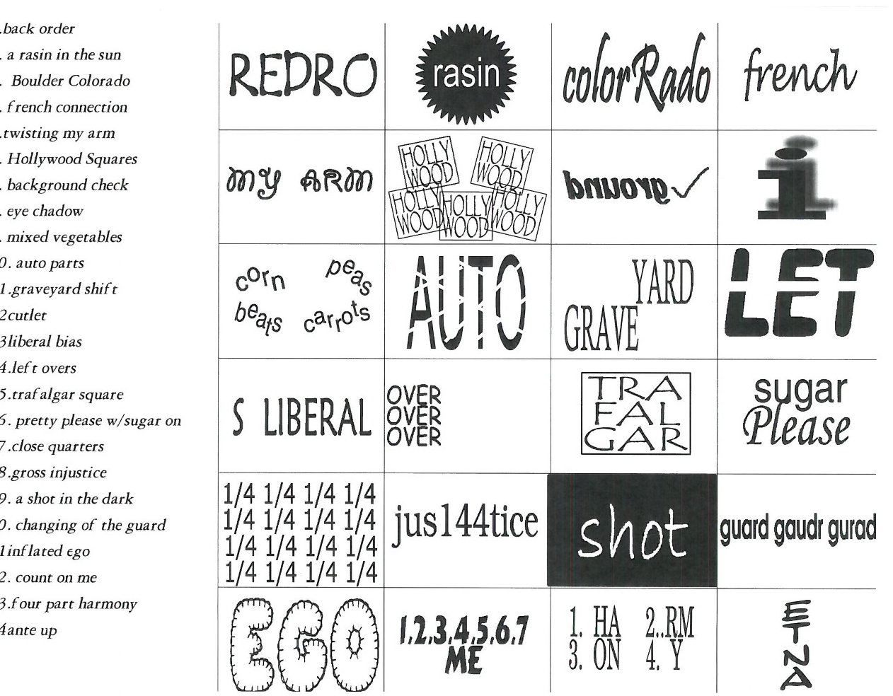
Mind Benders

Slide 22
Five Faves
5 favorite novels
5 favorite scary movies
5 worst movies that they've ever seen
5 favorite flowers
5 favorite vegetables
5 favorite dinners
5 foods they'd prefer not to eat again
5 cities they'd most like to visit
5 countries they plan to see
5 favorite TV shows of all time
5 most disliked tasks to do around the house
5 favorite dogs

Slide 23
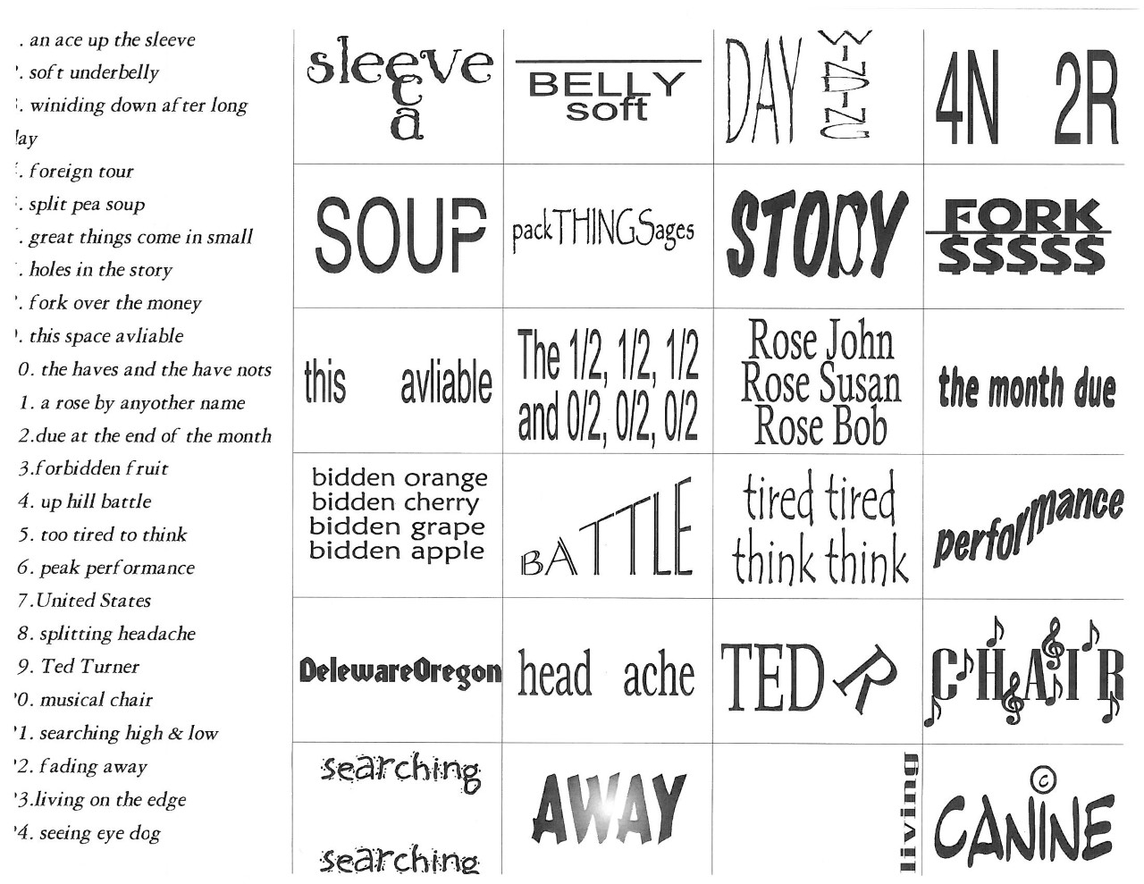
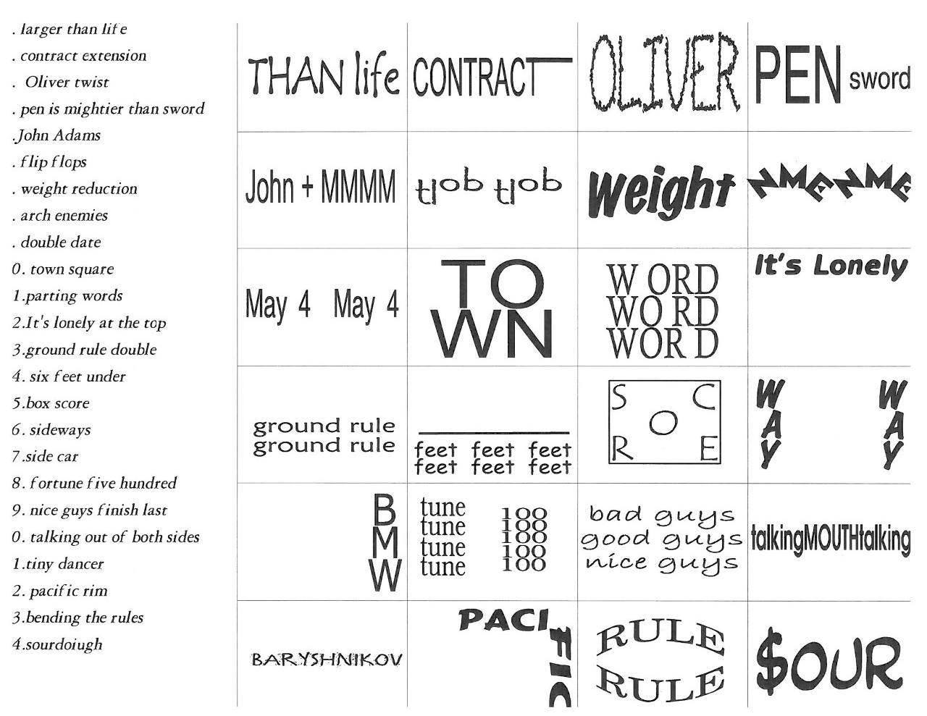
Mind Benders

Slide 24
Which Super Hero Power Would You Choose?
1. The ability to fly.
2. Time-travel ability.
3. Invisibility.
4. X-ray vision.
5. The power to change forms.
6. The ability to read minds.
7. The ability to see into the future.
8. Super hearing.

Slide 25
Which Super Hero Power Would You Choose?
1. Flying – You like to see the "big picture" of life and how things fit together. Little details annoy you. You enjoy being free and taking risks. Career clue: You'd make a good pilot or astronaut. Or consider a job that will let you affect policies, maybe in government or a public research group.
2. Time travel - You are interested in the causes of things and how past mistakes can used to shape the future. You're very curious about how different people live. Career clue: A career in scientific research, history, or human behavior might be the place for you. You might enjoy a job where you can affect the future.
3. Invisibility - You tend to be shy, or a very keen observer. Or both. You like to know everything that is going on around you. Career clue: Some good careers for observers, a writer, artist, or private investigator.
4. X-ray vision - You like to "see through" problems and go to the heart of an issue. You enjoy finding problems that other people can't even see. You also enjoy solving problems. Career clue: Physics, politics, math, and medicine are fields that need skilled problem-solvers.
5. The power to change forms - You are s sociable person who likes to "fit it." Perhaps you want to be admired by the group. Either way, you're a real crowd pleaser! Career clue: Entertainment might be the field for you. Actors can "change forms" and be other people.
6. Mind reading - You're good at guessing what other people think. You can "see behind" what they're saying to what they're really thinking. Career clue: You might be a good counselor or psychologist. It's important for professionals in those careers to understand how other people think and feel.
7. Seeing into the future - You're creative and love adventure. You'd move right into the future if you could! You're always looking at what might be possible, and wondering how to make it happen sooner. Career clue: A career on the cutting edge of things might be right for you. Think about becoming an explorer, research scientist, inventor, or science fiction writer.
8. Super hearing - You pay close attention to sounds and patterns. You like to be fully informed about the latest news. Some might even say you're nosy! Career clue: You might make an excellent reporter or gossip columnist. Or you might decide to become a musician.

Slide 26
Quick list of Faves!
My favorite color is _________________________________ My favorite pastime is _____________________________ My favorite thing to snack on is____________________ My LEAST favorite flavor of ice cream is ____________ My favorite movie is _______________________________ My favorite season is ______________________________ My favorite drink is _______________________________ When no one’s looking, I __________________________ I don’t like it when someone I don’t know _________ I think kids need more ___________________________ I hate to shop for ________________________________ My family thinks I _______________________________ My favorite food is ______________________________ My biggest pet peeve is __________________________ I like people who _________________________________

Slide 27
You’re a Lifesaver Take TWO different Colors
Yellow – Name something you hate to shop for Red – if money wasn’t a factor, where would you like to travel to? Orange – if a major motion picture was made about you, who would play you?
Purple – if there was a theme song that played every time you walked into a room, what would it be?
Green – if you could get any celebrity to be a spokesperson for your job/organization, who would it be?

Slide 28
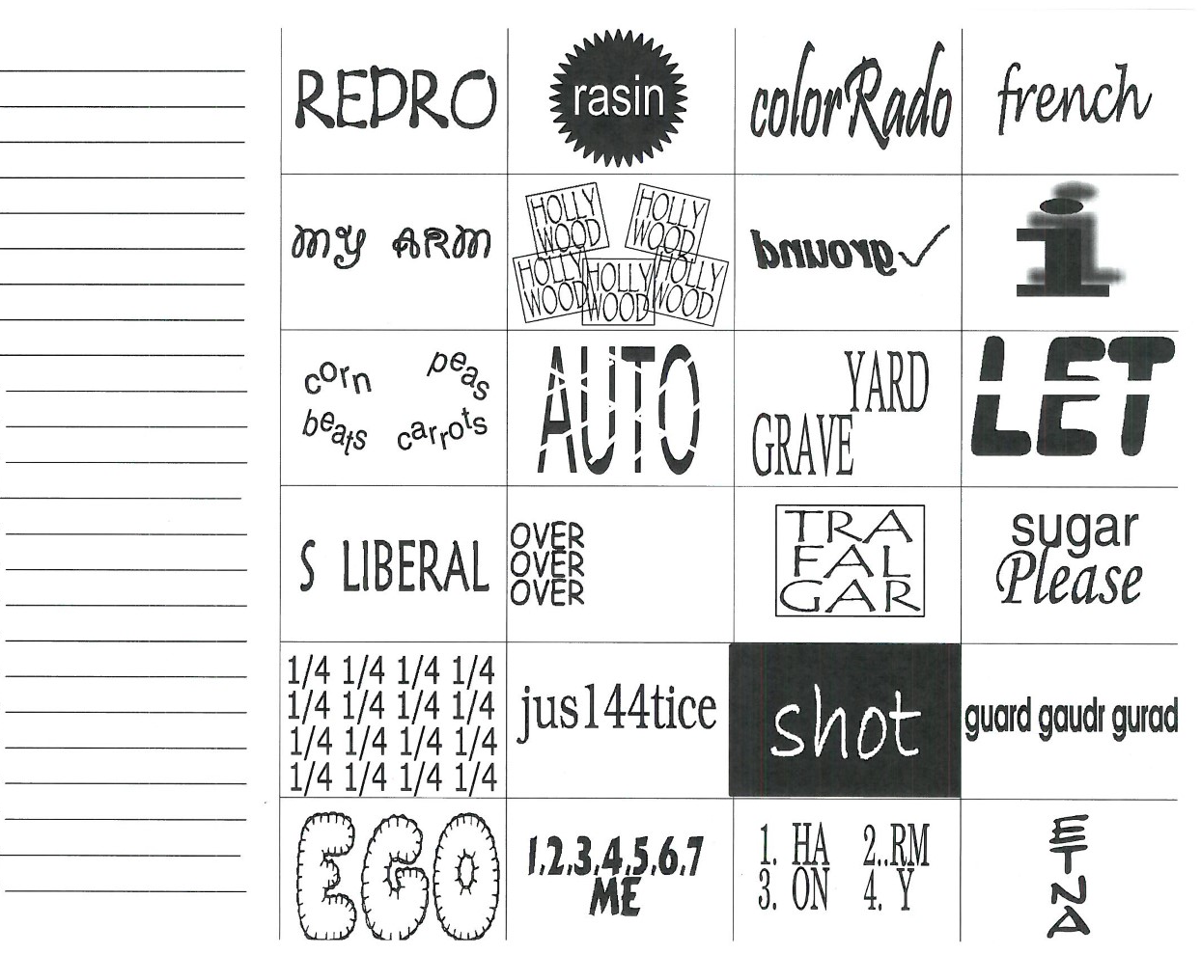
Mind Benders

Slide 29
Thank You! Mike mhauser@ag.arizona.edu Amy aparrott@ag.arizona.edu

