Slide 1
BEING OF USE – YOUR JOURNEY IN AMERICORPS
Bob Shogren, M.Ed.

Slide 2
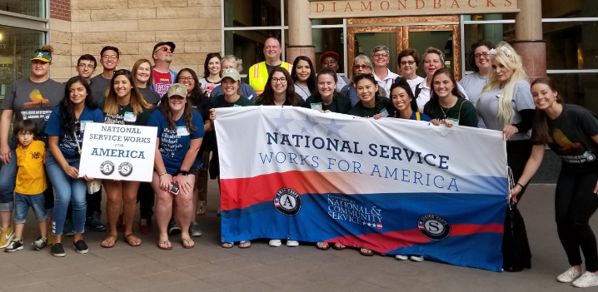
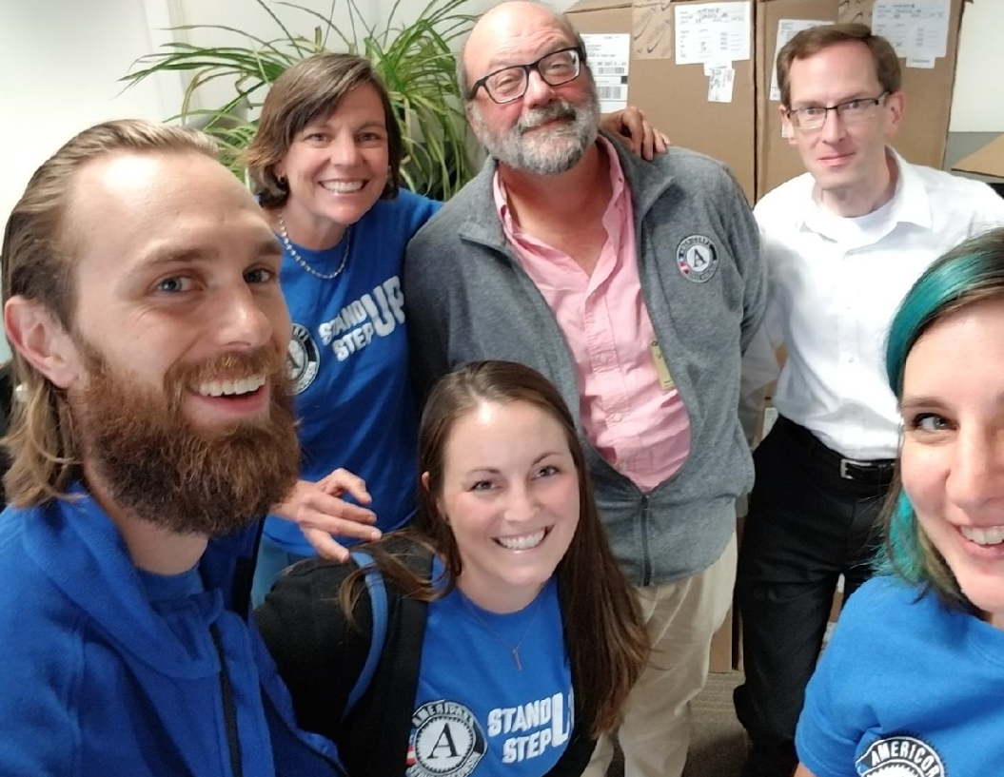
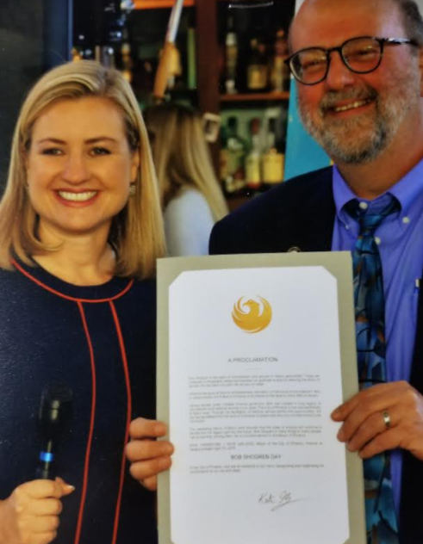
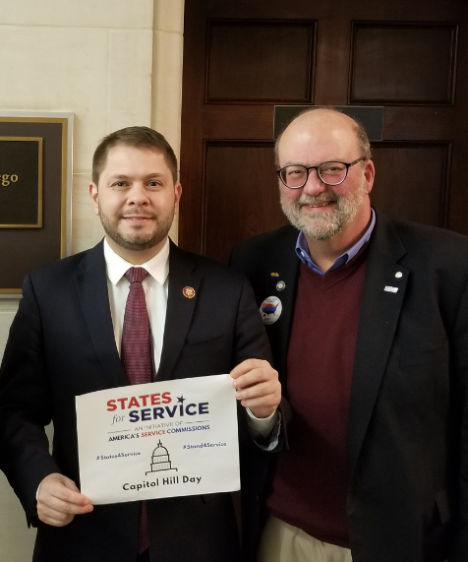
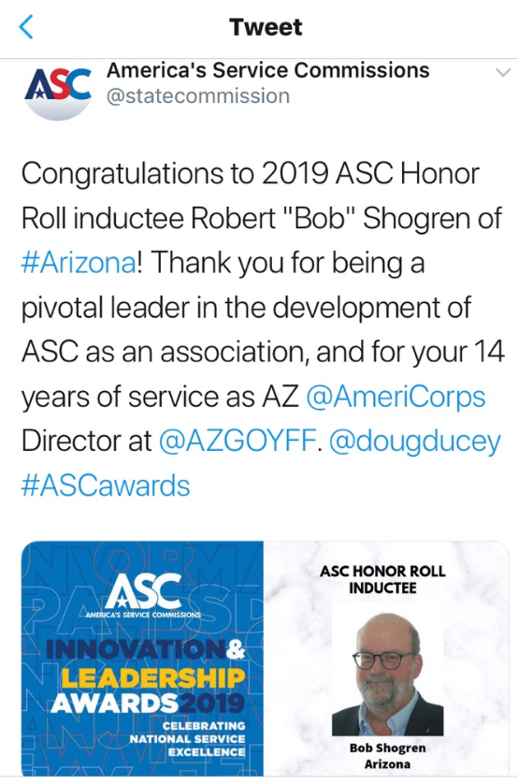

Slide 3
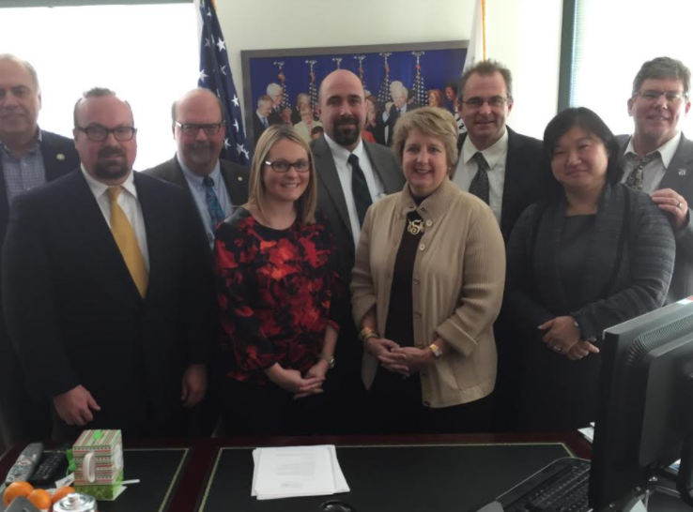
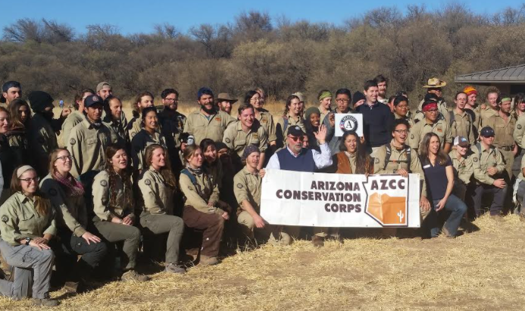
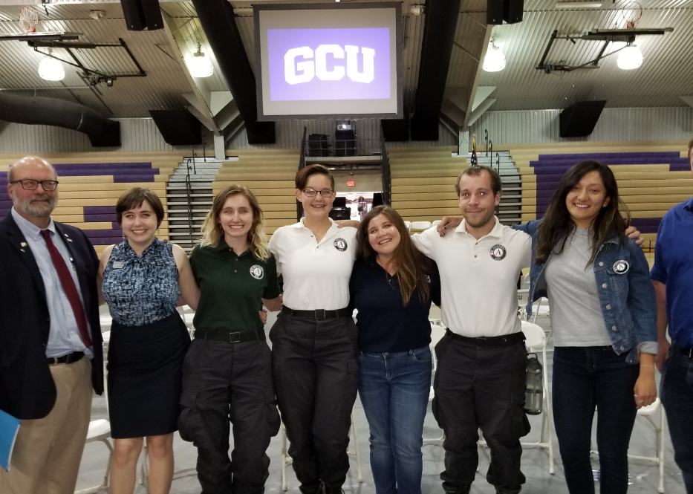
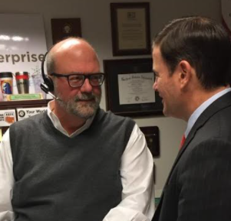
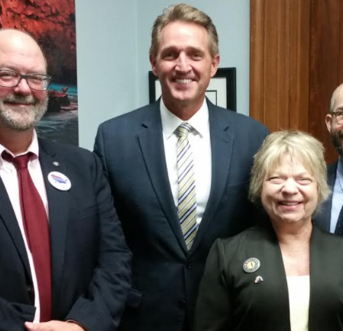

Slide 4
Observations and
reflections
about service
in AmeriCorps

Slide 6
WHAT WE HAVE LEARNED…
https://lucid.app/lucidspark/invitations/accept/e8ce05fd-8a70-49ff-b3a6-1f9ef1ed3e32?viewport_loc=-8%2C-8%2C1920%2C937%2C0_0

Slide 7
BEING OF USE – YOUR JOURNEY IN AMERICORPS
Bob Shogren, M.Ed.

Slide 8
AmeriCorps VISTA Oath
I do solemnly swear (or affirm) that I will support and defend the Constitution of the United States against all enemies, foreign and domestic; that I will bear true faith and allegiance to the same; that I take this obligation freely, without any mental reservation or purpose of evasion; and that I will well and faithfully discharge the duties of the office on which I am about to enter. So help me God.

Slide 9
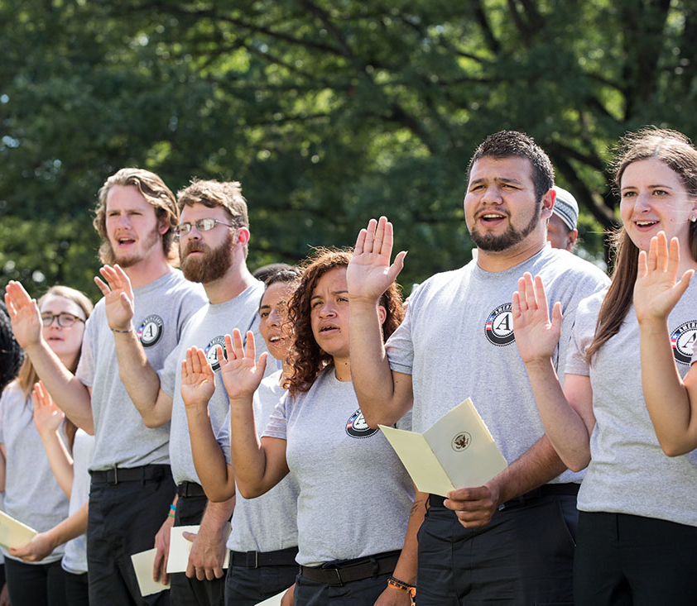
AmeriCorps Pledge
I will get things done for America - to make our people safer, smarter, and healthier.
I will bring Americans together to strengthen our communities.
Faced with apathy, I will take action.
Faced with conflict, I will seek common ground.
Faced with adversity, I will persevere.
I will carry this commitment with me this year and beyond.
I am an AmeriCorps member, and I will get things done.

Slide 10
AmeriCorps Pledge
I will get things done for America - to make our people safer, smarter, and healthier. I will bring Americans together to strengthen our communities. Faced with apathy, I will take action. Faced with conflict, I will seek common ground. Faced with adversity, I will persevere. I will carry this commitment with me this year and beyond. I am an AmeriCorps member, and I will get things done.
AmeriCorps VISTA Oath
I do solemnly swear (or affirm) that I will support and defend the Constitution of the United States against all enemies, foreign and domestic; that I will bear true faith and allegiance to the same; that I take this obligation freely, without any mental reservation or purpose of evasion; and that I will well and faithfully discharge the duties of the office on which I am about to enter. So help me God.

Slide 11
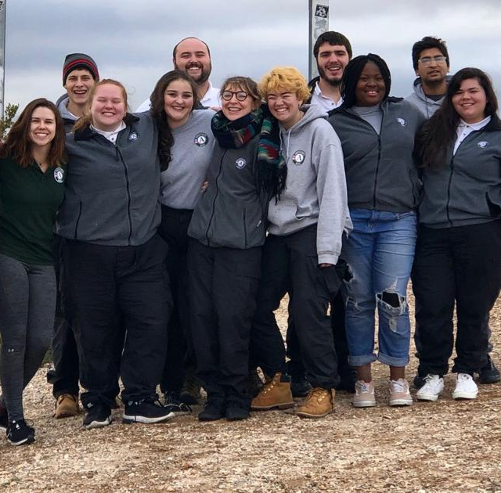
2017 - Five States; 15 virtual focus groups, 367 phone interviews
AmeriCorps is a transformative experience with numerous benefits for service members, host organizations and communities
Nonprofits reported that AmeriCorps offers the opportunity to significantly expand organizational capacity
AmeriCorps members garner personal and professional networks and skills and changes career trajectory
Employment pipeline
Investing in yourself is the best investment you will ever make. It will not only improve your life, but it will also improve the lives of all those around you. - Robin Sharma

Slide 12
Although other findings may surface over the course of the study, the following primary hypotheses will be tested:
AmeriCorps member involvement at an organization leads to job creation at that organization; however, the majority of jobs are located elsewhere.
There is a positive effect of internships and national service on employment outcomes, but informal volunteerism has no effect.
There is a greater positive relationship of internships and national service on employment outcomes among Latinos, African Americans, American Indians, and people with disabilities.

Slide 13
The Arizona AmeriCorps Experience
2012 – 431 AmeriCorps members and 75 mentors representing 16 Arizona AmeriCorps programs participated in an ongoing external evaluation
While the results reported were based on self-ratings, there was ample supportive evidence available through rich narrative responses to validate these responses. The members seemed willing to share their highs and lows and to exercise keen self-reflection.
Further, the ratings and narratives provided by their mentors strongly aligned with those of the members. If anything, the members tended to downplay their impacts.
The evaluation provided ample evidence of the positive personal and professional growth of AmeriCorps members; their varied and considerable impacts on people, institutions, and environments; their growing commitment to future service; and frequent “defining moments” during their national service that will surely shape future pathways.

Slide 14
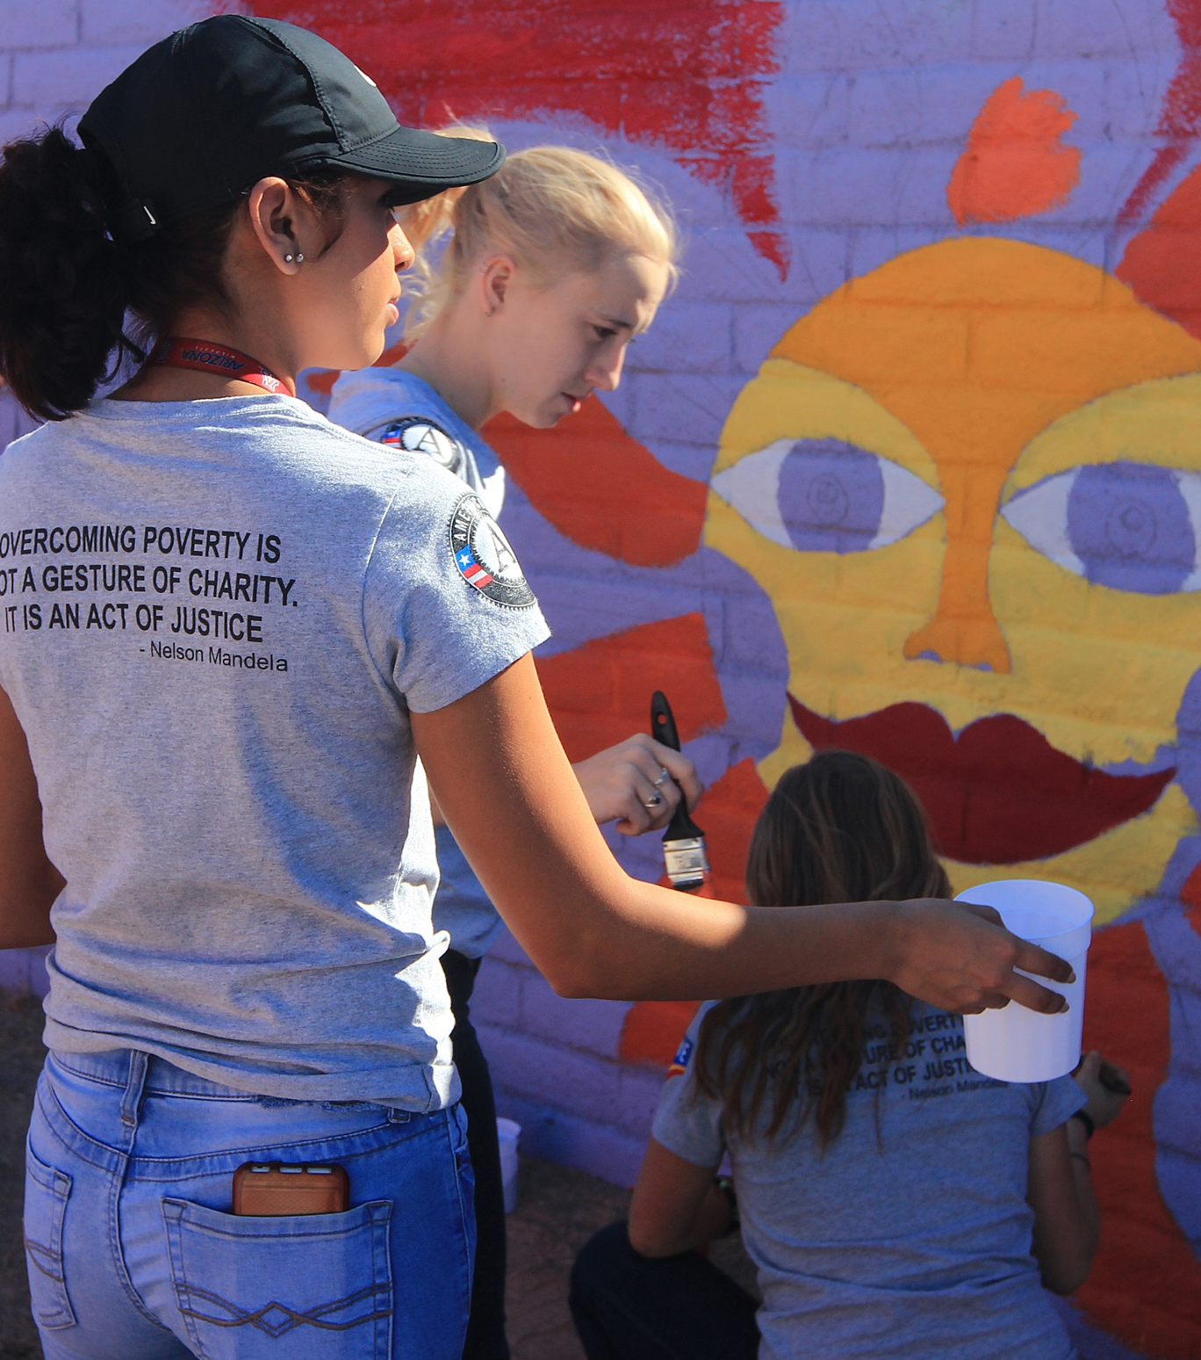
RESULTS
78% reported extraordinary growth
The members described rich learning opportunities in areas new to them. They were encouraged to take initiative and stretch their limits. They served communities and populations with which they often had no prior experience. They reported newly gained confidence, enhanced skill sets, and personal experiences that were life-transforming.
74% felt that the differences they made were extraordinary
Members were certain that they had touched the lives of another or others in profound ways. Others reported mastering skills or successfully performing tasks that they felt at the time were well beyond their capabilities. Still others focused on the innovations they had brought to their host organizations or at schools or other institutions they served.
78% reported that their AmeriCorps experience had made them more employable or a more capable volunteer.
The complementary narrative responses to the probe, “How have your AmeriCorps experiences served as a pathway to future employment or to expanded roles in the community?” produced mostly optimistic forecasts. Some pointed to full-time employment they had already secured due at least in part to their service with AmeriCorps. Many indicated having greatly expanded networks and stronger resumes, as well as deeper understanding of what they can contribute.

Slide 15
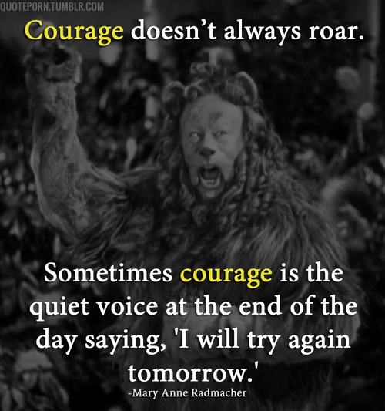
All In
The courage to make a personal, commitment to being of service demonstrated consistently in thought, word and action.

Slide 16
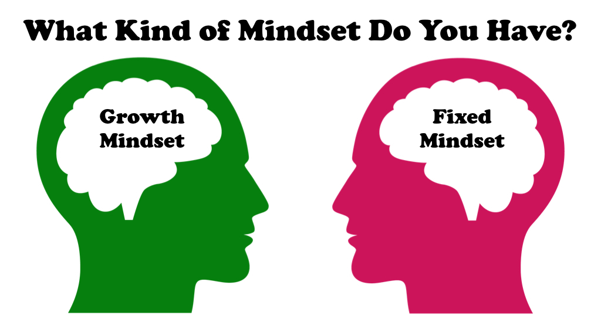

Slide 17
Characteristics of a Fixed Mindset
Believes intelligence and talent are fixed
Sticks with what they know
Believes putting forth effort is worthless or fruitless
Believes personal failures define who they are
Hides flaws so not to be judged as a failure
Avoids challenges to avoid failure
Tends to give up easy
Ignores feedback from others
Views feedback as personal criticism
Feels threatened by the success of others

Slide 18
Characteristics of a Growth Mindset
Believes intelligence and talents can be developed
Believes effort is the path to mastery
Believes mistakes are an essential part of learning
Views failure as an opportunity to learn
Believes failures are just temporary setbacks
Embraces challenges 4/4
Welcomes feedback from others in order to learn
Believes feedback is a guide to further improvement
Views feedback as a source of information
Views other’s success as a source of inspiration and information

Slide 21
The Cider House Rules tells the story of how, by writing one's own rules and making one's own choices, which Homer learns to do by the end of the film, one can lead a gratifying life and truly "be of use," which reflects John Irving's stance on how human beings should ultimately be able to make their own decisions.
In The Cider House Rules, we see how the conflict between traditional and cinematic histories that so often exists is ultimately dissolved. One of John Irving's principle aims when producing this novel and film was to create a portrayal of abortion that was true to its time and its history and to make a statement about the subject of abortion that was bolstered by its historical accuracy. It is clear that Irving's pro-choice leaning is woven throughout the film and very much espoused through the characters that he created. Irving has stated many times that he wanted readers and viewers to come away from The Cider House Rules with the feeling that, despite the fact that Dr. Larch lied to Homer about having a bad heart so he could avoid going to war, Homer really did have a good heart and so did Dr. Larch. Irving ultimately makes the argument that one can practice abortion and still be a good and useful person, can still have a good heart. At the end of the film, we see how Homer and Dr. Larch truly are the "princes of Maine" and "kings of New England" that they christen the orphans as when they say goodnight to them each evening.

Slide 22
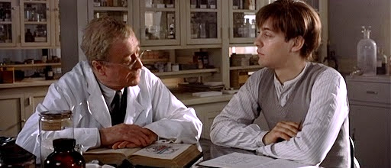
https://lucid.app/lucidspark/invitations/accept/0541e291-2dc1-41cd-8bdb-91bebd0f2d13?viewport_loc=25%2C-169%2C1920%2C937%2C0_0

Slide 23
Useful
Respect
Daily practices
Share work plans
Manage expectations
Organized; tidy
Listen Deeply
Share yourself
Seek advise
Quality work
Fill gaps
Anticipate what’s next
Get things done
Be present
Playful
Make their day
Choose your attitude
Not Useful
Waiting to be asked
Late
Ill-timed communications
Uncommunicated, independent action
Live Upset
Needs come first
Aggressive
Sarcasm
Office gossip
Inaction

Slide 24
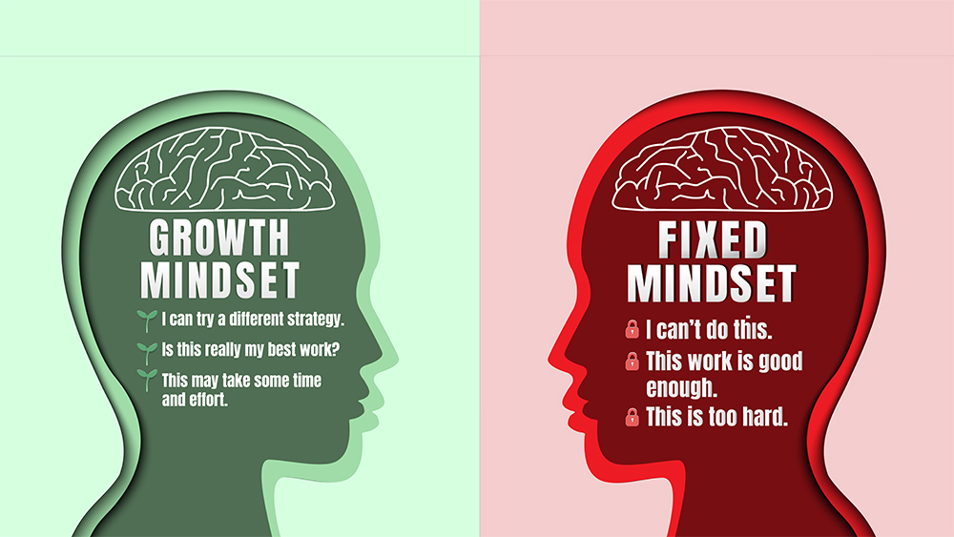

Slide 25
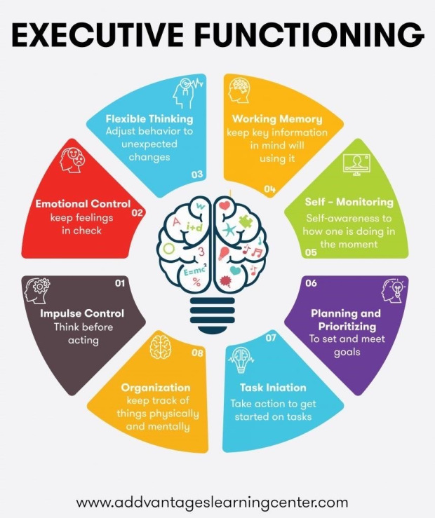
SELF REGULATION
Self-regulation can be defined in various ways. In the most basic sense, it involves controlling one's behavior, emotions, and thoughts in the pursuit of long-term goals. More specifically, emotional self-regulation refers to the ability to manage disruptive emotions and impulses

Slide 26
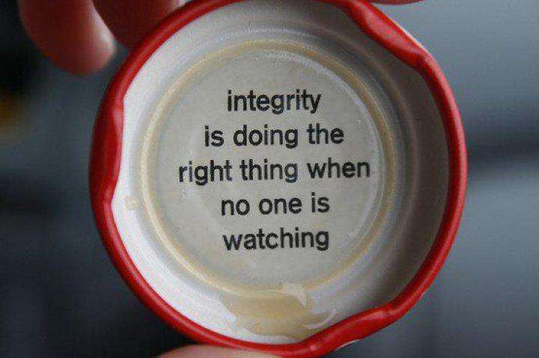

Slide 27
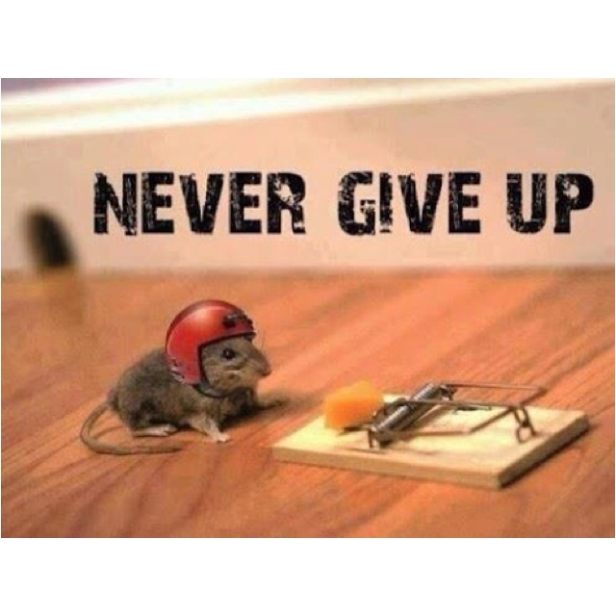
WHAT INSPIRES YOU?

Slide 28
“This is the true joy in life: being used for a purpose, recognized by yourself as a mighty one; being a force of nature, instead of a feverish, selfish little clod of ailments and grievances, complaining that the world will not devote itself to making you happy.
I am of the opinion that my life belongs to the whole community and as I live, it is my privilege to do for it whatever I can. I want to be thoroughly used up when I die; for the harder I work, the more I live. I rejoice in life for it’s own sake.
Life is no brief candle to me; it is a sort of splendid torch which I’ve got a hold of for the moment; and I want to make it burn as brightly as possible before handing it on to future generations.”

Slide 31
AmeriCorps Pledge
I will get things done for America - to make our people safer, smarter, and healthier. I will bring Americans together to strengthen our communities. Faced with apathy, I will take action. Faced with conflict, I will seek common ground. Faced with adversity, I will persevere. I will carry this commitment with me this year and beyond. I am an AmeriCorps member, and I will get things done.
AmeriCorps VISTA Oath
I do solemnly swear (or affirm) that I will support and defend the Constitution of the United States against all enemies, foreign and domestic; that I will bear true faith and allegiance to the same; that I take this obligation freely, without any mental reservation or purpose of evasion; and that I will well and faithfully discharge the duties of the office on which I am about to enter. So help me God.

Slide 33
“Remember…
The value of the AmeriCorps experience is the value you create in your service to others.
Thank you!

Slide 34
BEING OF USE – YOUR JOURNEY IN AMERICORPS
Bob Shogren, M.Ed.
Casa Grande Alliance
cgadirector@gmail.com
(520) 836-5022

