Slide 1
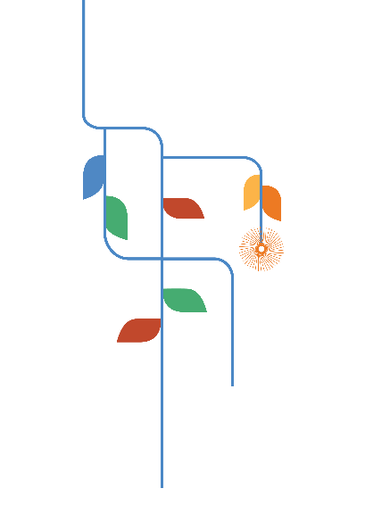
Civic Learning through School Participatory Budgeting:
An Inclusivity Approach
Presented by:
Madison Rock, Senior Program Coordinator, Civic Health
Kristi Tate, Director, Civic Health
October 22, 2020
arizonafuture.org
#arizonafuture #TheArizonaWeWant #azprogressmeters

Slide 2
Mission
The Center for the Future of Arizona
brings Arizonans together
to create a stronger and brighter
future for our state.
Notes:
The Center for the Future of Arizona is a nonprofit, nonpartisan organization that brings Arizonans together to create a stronger and brighter future for our state. We listen to Arizonans to learn what matters most to them, share trusted data about how Arizona is doing, bring critical issues to public attention, and work with communities and leaders to solve public problems.
Optional additional information for more detail: We work across the full spectrum of important issue areas and have deep and ongoing work in education, workforce and civic health, recognizing how central these are to a bright and prosperous future for our state.

Slide 3
The Arizona We Want
is a shared vision of
success around
what matters
most to Arizonans
that expresses their
highest aspirations
and hopes for the future.
Notes:
Describing The Arizona We Want

Slide 4
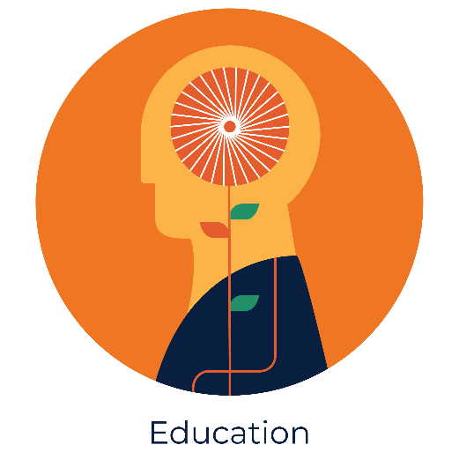
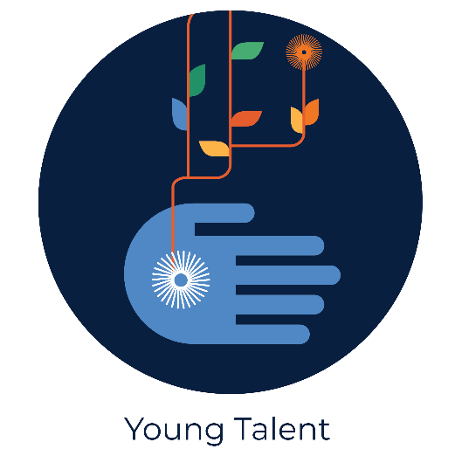
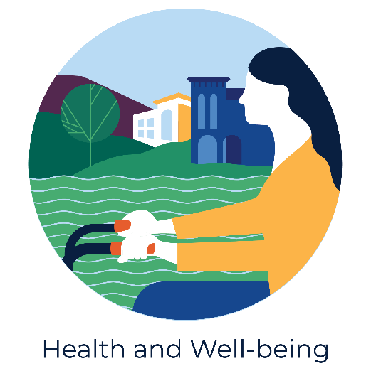
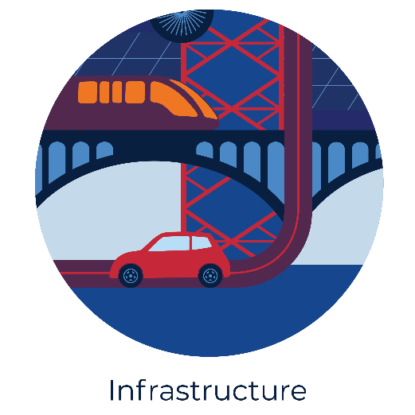
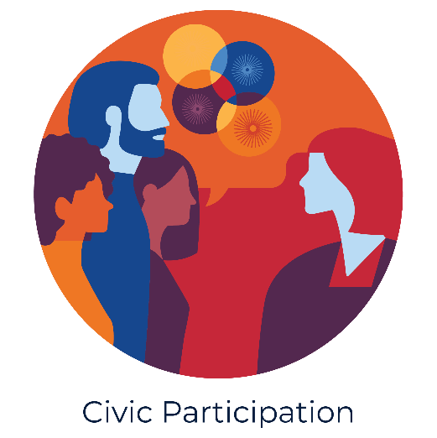
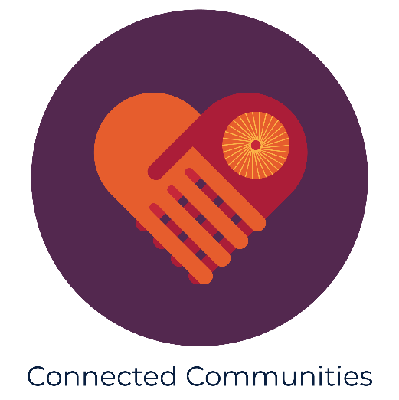
The Arizona We Want Progress Meters

Slide 5
Civic Health
Understood as the way communities are organized to define and address public problems. Building stronger more vibrant civic health across Arizona is central to our work.
Connected Communities
Civic
Participation

Slide 6
Notes:
Poll Title: In one word, what is your top issue of concern facing civic life in Arizona? https://www.polleverywhere.com/free_text_polls/OeU6tFMe2O68GoKrO9Km4

Slide 7
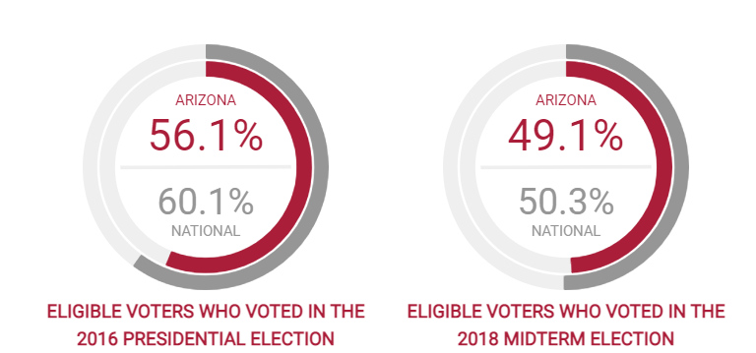
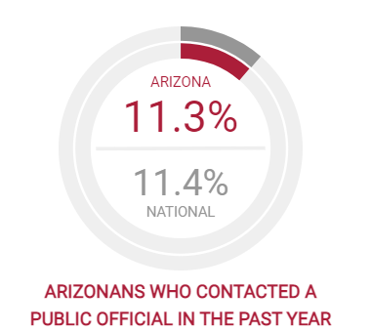
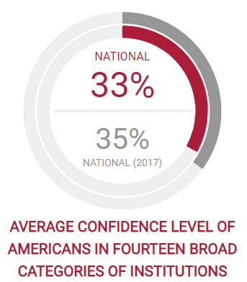
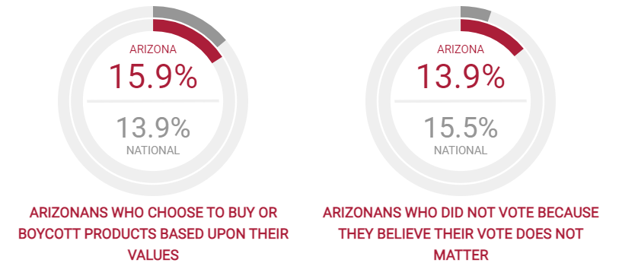
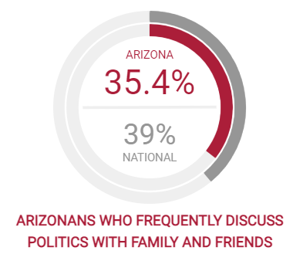
The Arizona We Want Progress Meters
Civic Participation Progress Meter

Slide 8
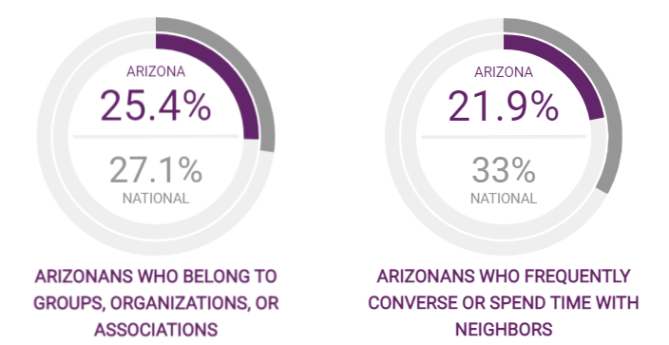
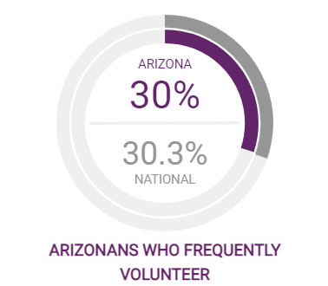
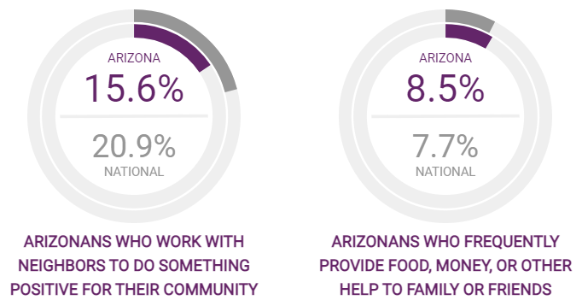
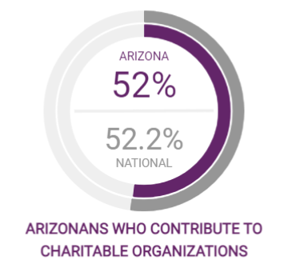
The Arizona We Want Progress Meters
Connected Communities Progress Meter

Slide 9
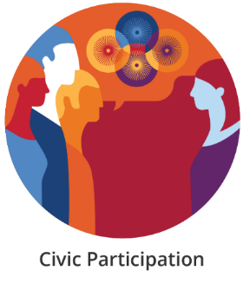
Interesting Metrics for Arizona CIVIC PARTICIPATION PROGRESS METER
Notes:
Arizonans, like residents of many other states, had a surprisingly high turnout for the 2018 midterm election. We saw record breaking turnout in 2020 with 80% of registered voters participating in the Presidential election.
In 2016, Arizonans who did not vote in the most recent election were asked why. Almost 20% of them said they were not interested, that their vote wouldn’t make a difference. This was higher than the national average of 15%. In 2018, this trend had started to shift for Arizona.

Slide 10
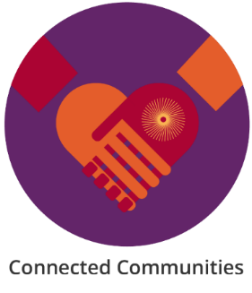
Interesting Metrics for Arizona CONNECTED COMMUNITIES PROGRESS METER
Notes:
Connections between Arizonans in our communities are really important to establish a sense of place and to help people feel at home in their neighborhoods.
While Arizonans are more generous on average than our peers in other states in providing help to our friends and neighbors, we do not generally spend much time with our neighbors.

Slide 11
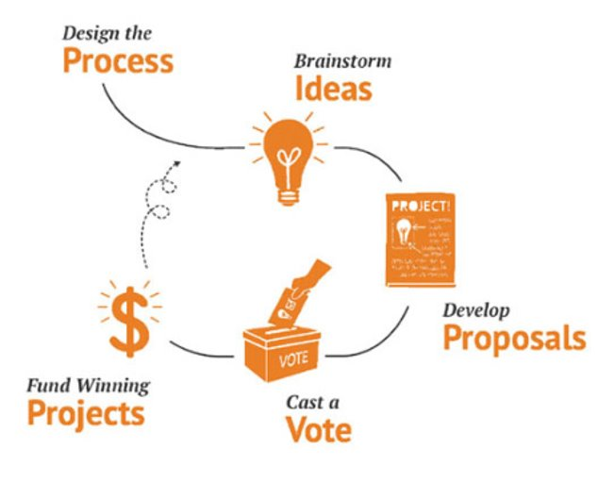
Participatory Budgeting in Schools
PB in Schools is an innovative civic learning tool designed to build student agency, collaboration, and critical thinking skills while creating pathways and opportunities for students to contribute to their communities and civic life.
Notes:
The data presented by the civic health progress meters also informs our own strategy at CFA, specifically the point around Arizonan’s belief in the power of their voice and voter turnout rates by age further illuminate the need to develop innovative & inclusive strategies that empower and equip young people with the tools, resources, and pathways necessary for lifelong participation in civic life. School PB is an innovative civic learning program that does just that. SPB is designed to build student agency, collaboration, and critical thinking skills while creating pathways and opportunities for students to contribute to their communities and civic life for the long-term. Through SPB students learn democracy by doing by deciding how a portion of their school district’s budget is allocated toward campus improvement projects.
The school model stems from the widely adopted municipal PB model founded in 1989 Porto Alegre, Brazil where community members directly decide how to spend a portion of a public budget. The process has since grown wildly with upwards of 11,000 PB processes implemented globally. In 2016, Phoenix Union, in partnership with CFA and the national nonprofit Participatory Budgeting Project, launched the first-in-the-nation PB process at the school district level.
Regardless of the setting, PB takes place in 5 key phases, but for our purposes I will describe them from the perspective of school implementation:
Students propose ideas to improve the school community.
Students transform ideas into proposals by conducting research on cost and feasibility.
Students deliberate on viable proposals and discuss their pros and cons.
Students vote to select winning projects.
Winning projects are funded and implemented.

Slide 12
Participatory Budgeting in Schools
School PB at Phoenix Union
Notes:
To provide a bit more texture to the process, let’s watch a video created during the pilot year of PB with Phoenix Union in 2016.

Slide 13
Participatory Budgeting in Schools
50,000+ students engaged annually in civic process and
4,500 students registered to vote for AZ elections since 2016
Engages Arizona’s Youth in Civic Life
Why does it matter?
Why it’s important to AZ’s future?
How does it transform?
Students “learn democracy by doing” through advocacy for improvement projects on their school campuses
Builds stronger school communities and develops students who are more informed, equipped and empowered to participate in civic life
Creates a pipeline of civic leaders who are trained to be problem-solvers, innovators and thinkers
Notes:
Since 2016, School PB in Arizona has grown significantly. We are now reaching upwards of 50,000 students in 39 schools across five school district annually, including Phoenix Union, Chandler Unified, Carson Junior High in Mesa Public Schools, Queen Creek Unified, and Sunnyside Unified in Tucson, AZ .
Through partnerships with local voter engagement and electoral institutions, we have also registered 4,500 new voters for future Arizona elections through School PB vote days.
Not including this year’s investments, nearly half a million dollars have been allocated to School PB and funded over 65 student-led projects to improve their campuses. Funded projects include shade structures, water bottle refill stations, school spirit statues and murals, bathroom and cafeteria improvements, and social emotional learning projects like a school therapy dog and meditation room.
The PB process provides students with meaningful opportunities to improve student agency; increases student civic knowledge, skills, attitudes, values, and dispositions like problem-solving, teamwork, and collaboration; PB also builds community & improves school climate by improving cohesion, trust and communication between students, teachers, and school leaders.
Importantly, PB matters to our state’s future & improves civic health across Arizona because it creates a pipeline of young people who have cultivated the civic building blocks necessary for lifelong engagement in civic life and are prepared to work together to solve problems across issue areas to achieve the Arizona we want.

Slide 14
Participatory Budgeting in Schools
2020 – 2021 Process Implementation
All partners actively implementing PB in Schools
PXU, CUSD, SUSD, Carson Jr. High + QCUSD
Adapted Delivery Models for Distance Learning
Virtual & hybrid engagement to meet schools & students where they are
New & Expanded Focus Areas
School Safety
Inclusivity
Notes:
This year, it’s no stretch of the imagination to know that PB implementation has looked a bit different. Despite the many challenges presented by the pandemic, we are thrilled to share that all partners are actively implementing PB, including our newest partner in Queen Creek who is piloting the model for the first time with five of their campuses engaging students as young as elementary school through high school.
We’ve adapted the traditional in-person delivery model to meet schools and students where they are amid distance learning. Some of our partners have implemented the process completely online using various virtual engagement platforms and tools, while others have taken more of a hybrid approach.
This academic year, we’ve also seen the process take shape in new and expanded ways. Over the past four years, we’ve helped to fortify the foundation for Phoenix Union to take PB to new levels. We’ve been so excited to see Phoenix Union take PB to district-wide expansion and really embody PB as a decision-making tool by allocating $1.2 million dollars over the next three years to reimagine what school safety looks like on all 20 of their high school campuses.
We’ve also deepened our commitment & understanding of inclusivity in the PB process which we’ll discuss in more detail today. Through partnership with the Arizona Developmental Disabilities Planning Council and ASU Participatory Governance Initiative, the inclusive process focuses on engaging students with disabilities in every phase of the process.
The data further points to this focus as a critical need for improving civic life throughout our state. We know from prior research that people with disabilities are less likely to be civically engaged, and that youth who have opportunities for civic engagement in schools are more likely to engage in civic and political life as adults. In this context, there are concerning implications that arise when students with disabilities are often underrepresented in spaces that promote civic engagement (e.g. student government, civic-oriented school clubs). These findings, along with the data in the Civic Health Progress Meters, have served as the foundation for the project on inclusive school participatory budgeting and become even more critical as the pandemic and subsequent shift to distance-learning have created new challenges for students with disabilities and the broader student body in building and maintaining a sense of community.

Slide 15
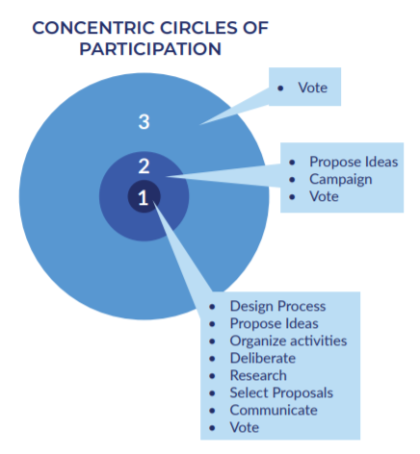
SPB: An Inclusivity Approach
Engaging students with disabilities in all phases of the PB process
Pilot Year (2019-2020)
Mesa, Arizona
Carson Junior High
1,200 students
2nd Year (2020 – 2021)
Mesa & Tucson
Carson Junior High
Sunnyside HS
Desert View HS
12,000 students
Classroom & Whole School Approach
Notes:
The SPB process is inherently inclusive and is designed to reach students who aren’t typically tapped for leadership positions on campus. Despite this, CFA and PGI took note in our observations of the process in the first four years of implementation that participation varies greatly among the student body. This is what we refer to as the concentric circles of participation. In the inner most circle, we have the steering committee which typically engaged 20-30 students. These students design the process, propose ideas, organize activities, deliberate, research and select proposals, communicate with the rest of the student body, and vote on the final projects to be implemented. In the second or middle circle, we have a small group of students who may propose ideas for how to spend the funds, campaign for projects they like, and participate in the vote. And in the third and largest circle, we have the majority of the student body who is exposed to the process through the vote day.
CFA and PGI began our journey to increase inclusivity in the process with the goal of bringing as many students from the third concentric circle into the two inner most groups with a specific focus on engaging students with disabilities on the steering committee and in every phase of the process. We piloted the inclusive model in the 2019-2020 academic year with Carson junior high in Mesa, Arizona. Carson Jr. High has 1,138 students, with a significant overrepresentation of minority students when compared with the demographics of the city and approximately 18% of Carson’s students are enrolled in Special Education programs. In the pilot, roughly 40% of the students on the steering committee had a documented disability and were able to engage the entire student body through idea collection, deliberation, and the school wide vote. We also produced a toolkit with five promising practices for inclusive engagement that I will share in just a bit.
This year, we’re still working with Carson by trying out a classroom model where all students on the steering committee have a documented disability as well as testing out lessons learned from the pilot with Carson with two high schools in Sunnyside Unified in Tucson, Arizona. In total in year two, we are engaging about 12,000 students across the three campuses in inclusive SPB. We are also learning how to implement the inclusive model in a completely virtual setting.

Slide 16
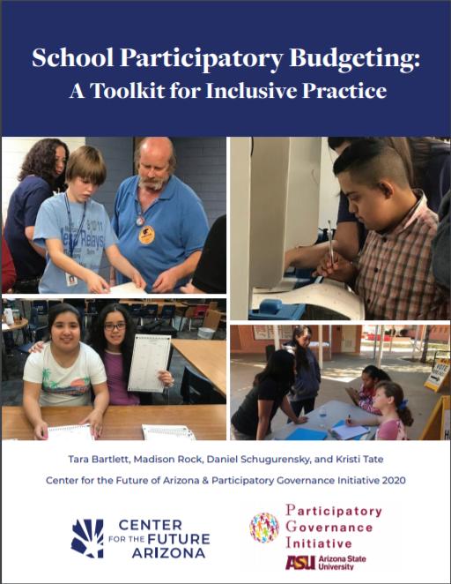
SPB: An Inclusivity Approach
Promising Practice 1: Ensure Campus Representation in Steering Committee Formation.
Promising Practice 2: Connect PB Process to Curriculum and Classroom Facilitation.
Promising Practice 3: Broaden Participation through Deliberation and Collective Decision-Making.
Promising Practice 4: Ensure Inclusive Communication to Reach All Learners.
Promising Practice 5: Emphasize Whole School Community Engagement.
Notes:
As I mentioned, CFA and PGI produces a toolkit based on our experiences in year one with Carson that outline five promising practices for inclusive engagement.
The first promising practice, is to ensure campus representation in steering committee formation or in leadership groups. In Carson, the steering committee student demographics were representative of Carson junior highs overall demographics with special education and several race demographics overrepresented since these groups are often underrepresented in electoral engagement. The steering committee was formed through a combination of student selection and teacher referrals provided by the social studies and special education departments. On the school's morning announcements, the steering committee information meeting was announced for all interested students to attend. At the information meeting we had approximately 40 students in attendance with 32 students committing to the yearlong program - 13 of which were students with a documented disability. We found by ensuring demographic representation on the steering committee, ideas collected were more reflective and responsive to the entire student body’s needs which is exemplified by the final winning project – a school therapy dog.
The second promising practices to ensure inclusion of the broader student body to the SPB process by implementing opportunities for information sharing, deliberation, and dialogue through a core curriculum classroom. In Carson Junior High, steering committee students presented to their peers to collect ideas, deliberate on the pros and cons of projects, discuss voting logistics, and support the creation of visual artifacts at the various touchpoints throughout the process during Social Studies since both 7th and 8th graders are required to take a social studies course.
Promising Practice three aims to broaden participation through deliberation and collective decision-making. In addition to the classroom interventions, we also created spaces for students to discuss the process by tabling at lunchtime and implemented a school-wide primary vote so the broader student body could weigh in on which projects would move from idea collection to proposal development using rank-choice voting.
The fourth promising practice to is ensure communication mediums are inclusive to all learners. Throughout the process students created posters, videos, and presentations to communicate with their peers. During tabling at lunch, students were encourage to draw pictures to depict their opinions on the projects. Campaign and vote day materials were made more accessible by utilizing large fonts, illustrations, and pictures to depict each project.
Lastly, we aimed to increase inclusivity in the process by engaging the entire school community. During the vote, teachers and staff were invited to cast a ballot for their top project alongside students. We also hosted a community vote for parents, siblings, and alumni to participate in the PB election.

Slide 17
Notes:
Our goal is that these promising practices reach beyond school participatory budgeting and can be adapted and applied in a variety of civic engagement and civic education settings to increase inclusivity of students with disabilities. With that, we want to know from you which of these promising practices is most relevant or practical to apply to your own work?

Slide 18
SPB: An Inclusivity Approach
Evaluation Strategies:
YPAR Methodology
Mixed Methods Approach
Surveys
Interviews & Focus Groups
Photovoice
KASP Indicators Survey
Knowledge
Attitudes
Skills
Practices
Notes:
We have taken a youth participatory action research (YPAR) approach were students work alongside researchers to evaluate the impact of the model. Through the YPAR methodology, we’ve implemented a mixed-methods approach to data collection which includes surveys, interviews and focus groups, and photovoice which has participants take photographs to illustrate the problem or question and is supplemented by interview data or simple sentences. These instruments are intended to evaluate student growth and learning related the four categories of civic indicators, Knowledge, Attitudes, Skills or Practices (KASP)

Slide 19
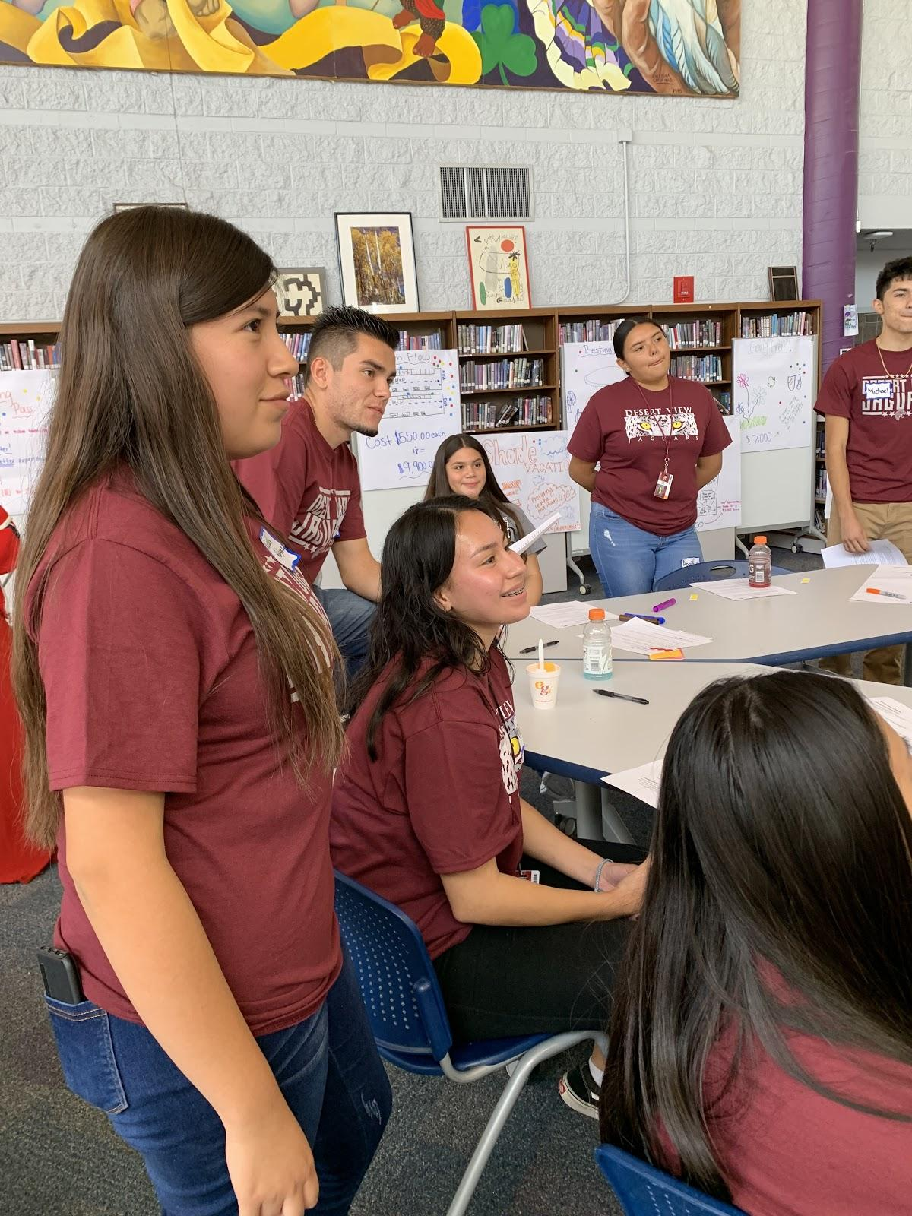
SPB: An Inclusivity Approach
Project Outcomes:
Increased self-advocacy
Increased trust, communication, and solidarity
Gained long-lasting Civic KASP
Created a more inclusive, connected school community
Provided a place for students to work together, build relationships, and share leadership roles
Notes:
Through our research, we found that students make significant improvements in the civic knowledge, attitudes, skills and practices (KASP). The increased self-advocacy, trust, communication and solidarity throughout the school communities. The process created a more inclusive and connected school environment and provided a place for students who wouldn’t normally have the opportunity to work together, build relationships, and share leadership and decision-making roles.

Slide 20
SPB: An Inclusivity Approach
“PB makes me feel more important because I help make decisions.”
“At first I was nervous, but now I know I can do it.”
“I learned to advocate for myself because I knew I had a good idea.”
Notes:
To wrap up, I want to leave us with a few quotes from Carson students and teachers engaged in the process:

Slide 21
Participatory Budgeting in Schools
Resources:
School Participatory Budgeting: A Toolkit for Inclusive Practice
Available for download at arizonafuture.org
The School PB Workshop: Professional Development for Educators
Coming to a computer near you June 15, 2021
Contact:
Madison Rock, Senior Program Coordinator, Civic Health
Madison.rock@arizonafuture.org
602.316.2065
Notes:
For additional resources on how to bring SPB to your community or increase inclusivity in civic engagement, our toolkit is available for download for free on our website. We are also launching a professional development workshop for educators this summer with a deep dive on inclusive SPB! If you are interested in attending the workshop, please contact me or drop your information in the chat and I will be sure to follow up with you.

Slide 22
Thank You
October 22, 2020
arizonafuture.org
#arizonafuture #TheArizonaWeWant #azprogressmeters

